Slide 1

Economic & Concrete Supports, Family Well-being, and Reducing Risk for Child Welfare Involvement
Bryan Samuels, Executive Director, Chapin Hall
Children’s Action Alliance
Families First Forum
Phoenix, AZ / November 2024

Slide 2
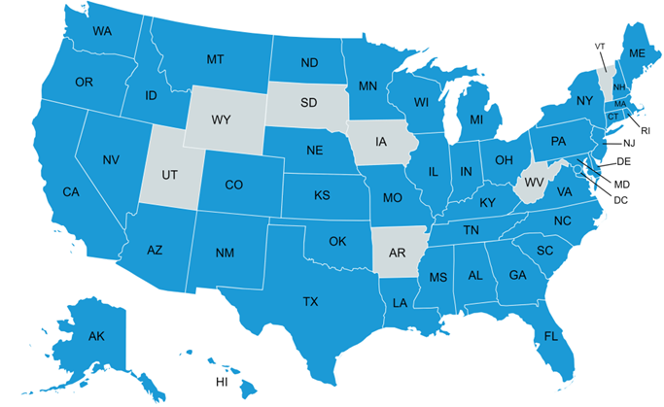
CHAPIN HALL TRANSLATES RESEARCH INTO POLICY AND PRACTICE CHANGE
Identify the problem or concern
Identify research questions or analysis
Bring forward findings or analysis results
Propose policy or practice changes
Develop implementation plan
Monitor and change for desired results
How Chapin Hall Makes Change in the Real World

Slide 3
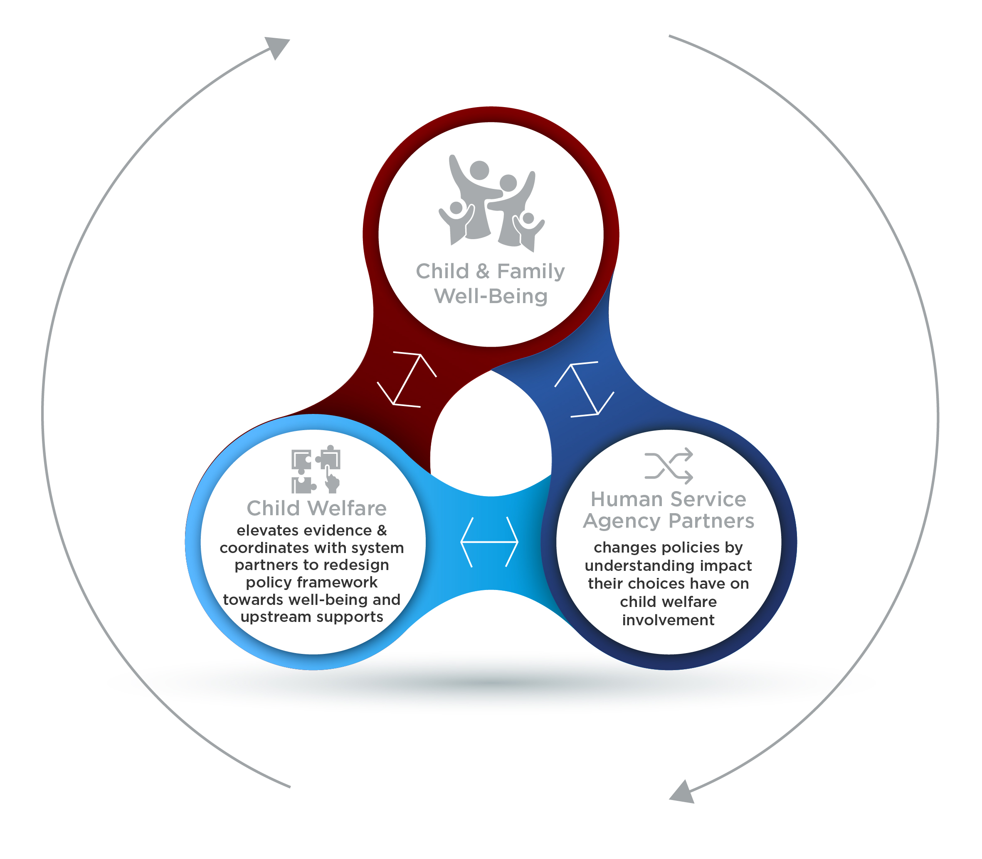
Evidence-based
Policy-Making to Build a Well-Being System: Making it ACTIONABLE
Equitable policy, program & service design centering the experiences and leadership of families, youth & communities
States take a holistic well-being approach to policy making focused on preventing child welfare involvement & high human and fiscal costs

Slide 4
nearly 85% of families investigated by child protective services have incomes below 200% of the federal poverty line
($49,720 for a family of 3 in 2023)
(Dolan, 2011 - National Survey of Child & Adolescent Well-Being II Baseline Report)
(HHS Poverty Guidelines, 2023)

Slide 5

60%+ of substantiated CPS responses nationally involve neglect only
…and provision of economic & concrete supports is associated with decreased risk for both neglect and physical abuse
(Child Maltreatment 2019)

Slide 6






Context Matters:
Impact of Historical & Contemporary Policy Choices
Overloaded & Destabilized Families
Unmet Service & Support Needs​
High Rates of Reported Neglect
Deployment of Authority to Investigate & Remove Children
Child Welfare Involvement
Disparate Access to & Lack of Sufficient Economic & Concrete Supports
Fragmented Human Service System
Deficit-Based Rigid & Piecemeal Policies
Mandated Reporting Laws
Economic Hardship

Slide 7


Context & Economic Factors Matter
Economic factors are associated with neglect outcomes above individual-level parenting behaviors & capacities
Material hardship is associated with CPS involvement beyond caregiver psychological distress & parenting factors
The association of individual factors (such as caregiver substance abuse or mental health) with child maltreatment is reduced after accounting for poverty experienced by families receiving preservation services
    “…when the effects of poverty are accounted for, these individual factors lose their potency…”
(Slack, 2011)
(Yang, 2015)
(Escaravage, 2014)

Slide 8
Material Hardship Increases Risk for Child Welfare Involvement:
Both Neglect & Abuse
If low-income families experience at least one material hardship
~3x higher likelihood of neglect investigation
~4x higher likelihood physical abuse investigation
If low-income families experience multiple types of material hardship (after experiencing no hardships)
~4x higher likelihood of CPS investigation
~7x higher likelihood physical abuse investigation
(Yang, 2015)
*Dimensions of material hardship in this study included: food, housing, utilities & medical hardship

Slide 9










The Intersection of Family Economic Insecurity & Child Welfare Involvement
Most reliable economic predictors of child welfare involvement
Strongest predictors of
investigated neglect reports
Income Loss
Cumulative Material Hardship
Short duration of residence
Food pantry use
Cutting meals
Housing Hardship
Inability to receive medical care for sick family member
Difficulty paying rent
Utility shutoffs
Public
benefit receipt
(Conrad-Hiebner, 2020
systematic review)
(Slack, 2011
cross-study comparison)

Slide 10
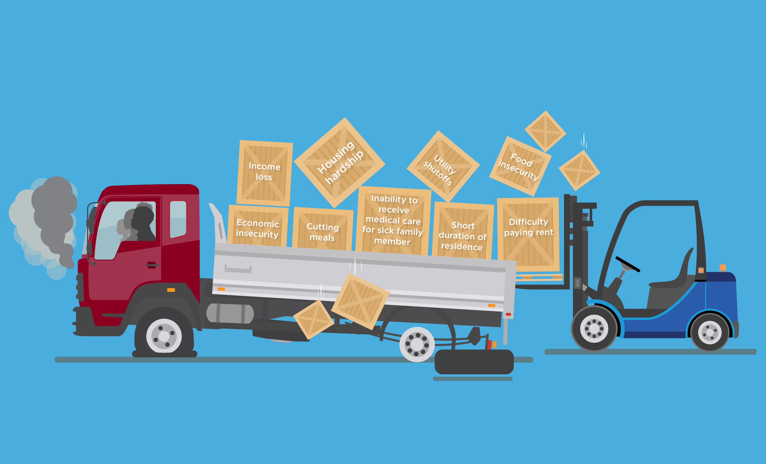
Multiple Material & Economic Hardships Can Overload Families
Multiple Material & Economic Hardships Overload Families and
Increase Risk for Child Welfare Involvement
Watch the Overloaded Parents Video by NSPCC
Visual created by Chapin Hall
Adapted from: (Conrad-Hiebner, 2020) (Slack, 2011) (Sweetland, 2021)

Slide 11
Evidence:
Relationship between Economic & Concrete Supports and Child Welfare Involvement

Slide 12







Decreased Access to Economic & Concrete Supports Is Associated with Increased Child Welfare Involvement
Reduced TANF benefits
Reduced income & negative earnings shocks
Increased risk for child welfare involvement
Lack of child care
Reduced employment
Lack of stable housing
Increased gas prices
(Ginther, 2017) (Ginther, 2022) (Paxson, 2003) (Yang, 2016) (Cash, 2003)
(Klevens, 2015) (Brown, 2020) (Berger, 2011) (Warren, 2015) (Cai, 2021)
(Weiner, 2020) (McLaughlin, 2017) (Bullinger, 2021) (Berger, 2015)
(Frioux, 2014) (Wood, 2012)

Slide 13
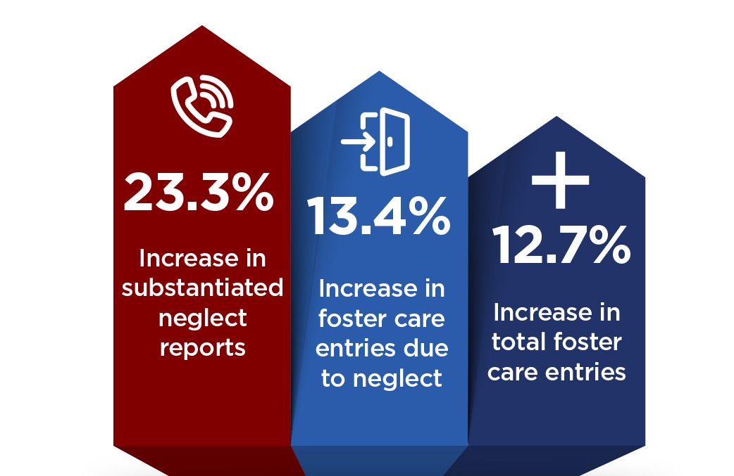
Lack of Access to Temporary Assistance to Needy Families (TANF)
Reminder: The first statutory goal of TANF is to support needy families so that children can remain safely at home or with relatives.
States that imposed total benefit loss as the most severe sanction for not meeting TANF work requirements:
(Ginther, 2017)
(Increases observed from 2004 to 2015)

Slide 14


Lack of Access to Child Care
For every additional child care concern reported by families receiving TANF, the risk of supervisory child neglect increases by 20%
Mothers entering substance use treatment who have difficulty securing child care are 82% more likely to self-report child neglect (compared to mothers entering treatment who don’t have this difficulty)
    Difficulty finding child care was a stronger predictor of maternal neglect than almost any other factor measured in this study, including mental health & severity of drug use
(Yang, 2016)
(Cash, 2003)

Slide 15

Reduced Employment
During the Great Recession (2007–2009), the rate of abusive head trauma (AHT) for children < 5 years old was considerably higher than during the period immediately before
AHT rate increased from 8.9 in 100,000 children before the recession to 14.7 in 100,000 children during the recession
(Berger, 2011)

Slide 16

Evidence of Causal Effect of Income on Risk for Child Welfare Involvement
Mothers who participate in TANF and are eligible to receive full child support for their children (and child support is disregarded in determining welfare benefits) are 10% less likely to have a child subject to a screened-in maltreatment report
(compared to mothers who are eligible to receive only partial child support payments)
  Even a modest increase in child support payments—averaging $100 per year—results in a decrease in screened-in maltreatment reports
(Cancian, 2013)
(randomized controlled trial - RCT)

Slide 17
Macro-Economic & Employment Supports

Slide 18
Earned Income Tax Credit (EITC)
10% increase in the generosity of refundable state-level EITC benefits is associated with:
    5% decline in reported maltreatment rates
    9% decline in reported neglect rates
Refundable state-level EITC (averaging $400 per year) is associated with a 13% decrease in hospital admissions for abusive head trauma for children < 2 years old* (even after controlling for poverty, race, education & unemployment)
(Kovski, 2022)
(Klevens, 2017)
* Approaches statistical significance

Slide 19
Minimum Wage
From 2004 to 2013:
States that increased the minimum wage beyond $7.25 per hour experienced a decline in child maltreatment reports
Every $1 increase in minimum wage was associated with a 9.6% decline in neglect reports (primarily for children < 12 years)
(Raissian, 2017)

Slide 20

Paid Family Leave (PFL)
Compared to states with no PFL policy, the implementation of California’s 2004 PFL policy (up to 12 weeks of partially paid leave) was associated with a decrease in hospital admissions for abusive head trauma:
among children <1 year old and
among children < 2 years old
(Klevens, 2016)

Slide 21
Concrete Supports:
Home Visiting & Child Care

Slide 22

Universal Home Visiting with Economic & Concrete Supports
Family Connects (FC) is a short-term, community-wide nurse home visiting program for families with newborns
Focuses on addressing material needs: 1–3 home visits to assess family needs, connect families to community resources, and provide education & intervention as needed
Randomized clinical trials of all families with births in select hospitals in Durham, NC over a 6-month period found that families randomly assigned to FC experienced:
  More positive maternal mental health (at age 6 months)*
  44% lower rate of CPS investigations (through age 2)
  39% fewer CPS investigations (through age 5)
  (compared to families who didn’t receive FC)
“The findings… suggest that, when implemented with high quality & broad reach, a brief postpartum nurse home visiting program can reduce population rates of child maltreatment .”
(Goodman, 2021)(RCT)
(Dodge, 2019)(RCT)
* Approaches statistical significance

Slide 23

Child Care Subsidies
Consolidated Appropriations Act of 2023 included a 30% increase in funding for the Child Care & Development Block Grant (CCDBG)
Each additional month that mothers who are low income receive a child care subsidy is associated with:
16% decrease in the odds of a neglect report
14% decrease in the odds of a physical abuse report
(in the following 12 months)
(Yang, 2019)

Slide 24
High-Quality Child Care
Reduces likelihood of child welfare involvement
Children who attended Early Head Start had fewer child welfare encounters between ages 5 and 9 (compared to those who didn’t attend)
Reduces likelihood of foster care entry
Children (ages 0–5) who participated in Head Start & were referred to child welfare for suspected maltreatment were 93% less likely to enter foster care (compared to children who did not receive any early childhood education service)
Helps prevent child maltreatment
Children who participated in Chicago Child-Parent Center preschool:
  52% less likely to be victims of confirmed maltreatment by age 17
  Lower rates of reported neglect
  (compared to non-participating peers)
Less than one-third of young children under child welfare supervision who live at home receive any early childhood education services
(Reynolds, 2003) (Green, 2014) (Klein, 2017)

Slide 25
Concrete Supports:
Health

Slide 26
Medicaid Expansion
States that newly expanded Medicaid in 2014 were associated with reductions in the average rate of child neglect reports per state-year:
13% reduction for children ages 0-5
15% reduction for children ages 6-12
16% reduction for children ages 13–17
(compared to states that did not expand Medicaid from 2008 to 2018)
North Carolina expanded Medicaid in 2023
(McGinty, 2022) (Urban Institute, 2021)

Slide 27
Concrete Supports:
Housing

Slide 28
Supportive Housing
Children of child welfare-involved families who face housing instability and receive a supportive housing program (housing voucher + case management) experience:
Fewer removals (9% vs. 40% in business- as-usual control group after 2 years)
Lower prevalence of substantiated maltreatment (8% vs. 26% in control group after 18 months)
Increased reunification (30% vs. 9% in control group after 2 years)
(Farrell, 2018) (RCT)

Slide 29
Permanent Housing Subsidies
HUD’s Family Options Study found that homeless families referred for permanent housing subsidies self-reported:
  50% fewer foster care placements
    (1.9% vs. 5% in the control group experienced at least 1 placement in the last 6 months)
  Lower rates of psychological distress
  Less intimate partner violence
  Fewer child behavior problems
  Greater housing stability & food security
(compared to a business-as-usual control group of homeless families at the 20-month follow-up)
(Gubits, 2015) (RCT)

Slide 30

Annual Costs of Child Maltreatment in the U.S.
$80 billion = direct & indirect costs of child maltreatment (2012)
$428 billion = economic burden due to substantiated child maltreatment (lifetime costs incurred annually) (2015)
$2 trillion = economic burden due to investigated child maltreatment (lifetime costs incurred annually) (2015)
(Gelles, 2012)
(Peterson, 2018)

Slide 31
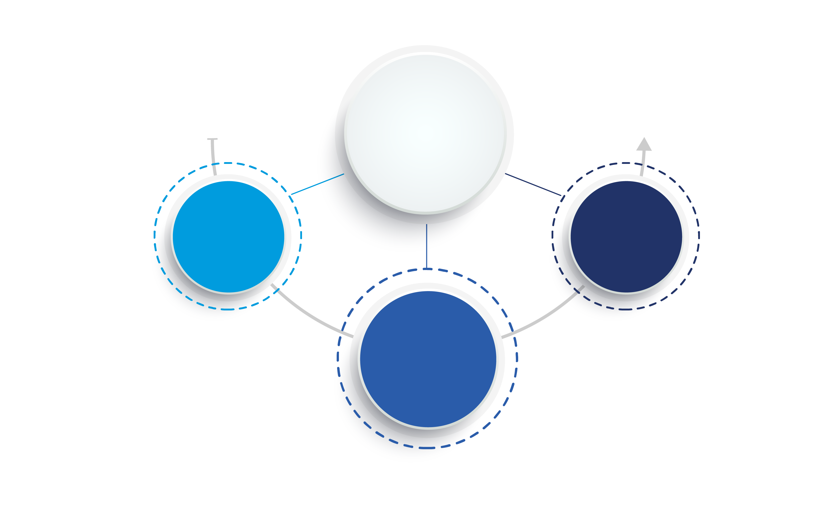



Economic and Concrete Supports (ECS): An Overview
Reduced access to ECS associated with INCREASED risk of child maltreatment & child welfare involvement
Increased access to ECS associated with DECREASED risk of child maltreatment & child welfare involvement
Economic & Concrete Supports
ECS evidence is consistent across time & types of studies:
Pelton, 1978 to
Pac et al, 2023
ECS evidence is ACTIONABLE
ECS evidence is
consistent across mechanisms:
cash assistance, child care, housing, health care, employment
supports, etc.

Slide 32








Sources of Evidence
How do the following studies show the impact of programs, policies, and strategies for reducing child welfare system involvement through economic & concrete supports?
Theoretical models and studies that illustrate the processes by which material hardship leads to child maltreatment
Research designed to detect the impact of a specific strategy through randomized controlled trials (RCT)
Analysis of decades of administrative data aligned with policy or other shifts
Natural experiments to assess public benefit programs
This vast body of science and growing preponderance of evidence informs our understanding of what has been effective and why and hypotheses about potential policy shifts & new pathways.
*Unless otherwise noted, all findings presented are statistically significant

Slide 33
CDC: Public Health Approach
Step 4: Assure Widespread Adoption
Step 3: Develop and Test Prevention Strategies
The strategies shown to be effective in step three are then implemented and adopted more broadly. Communities are encouraged to implement strategies based on the best available evidence and to continuously assess whether the strategy fits the community context and achieves its goal of preventing violence.
Step 2: Identify Risk and Protective Factors
Findings from the research literature and data from needs assessments, community surveys, key collaborator interviews, and focus groups are useful for designing prevention strategies. This approach, which uses these data and findings, is known as an evidence-based approach to program planning.
Step 1: Define the Problem
Knowing the magnitude of a public health problem is not enough. It is also important to understand what factors protect people or put them at risk for adverse outcomes. Understanding risk and protective factors helps identify where prevention efforts should be focused.
The first step in public health approach is to understand the “who,” “what,” “when,” “where,” and “how” associated with it. Grasping the magnitude of the problem involves analyzing data.

