Slide 1

Current Outlook for U.S. and Arizona Economy

Slide 2
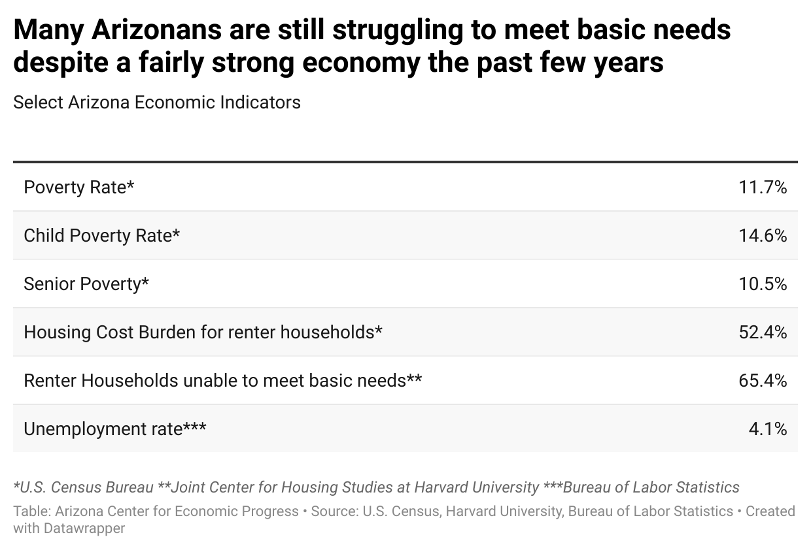

Slide 3
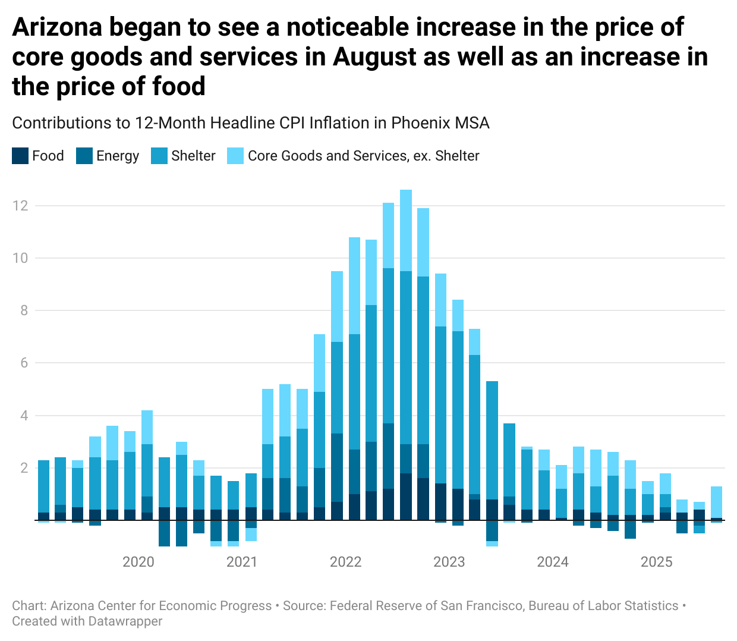

Slide 4
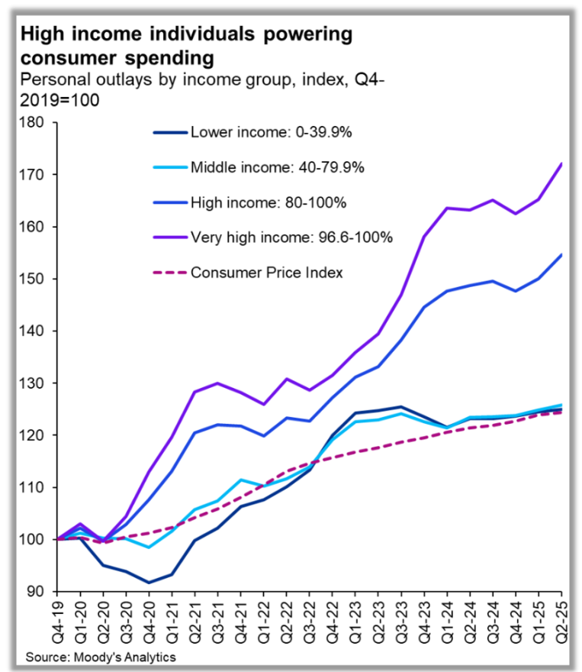

Slide 5
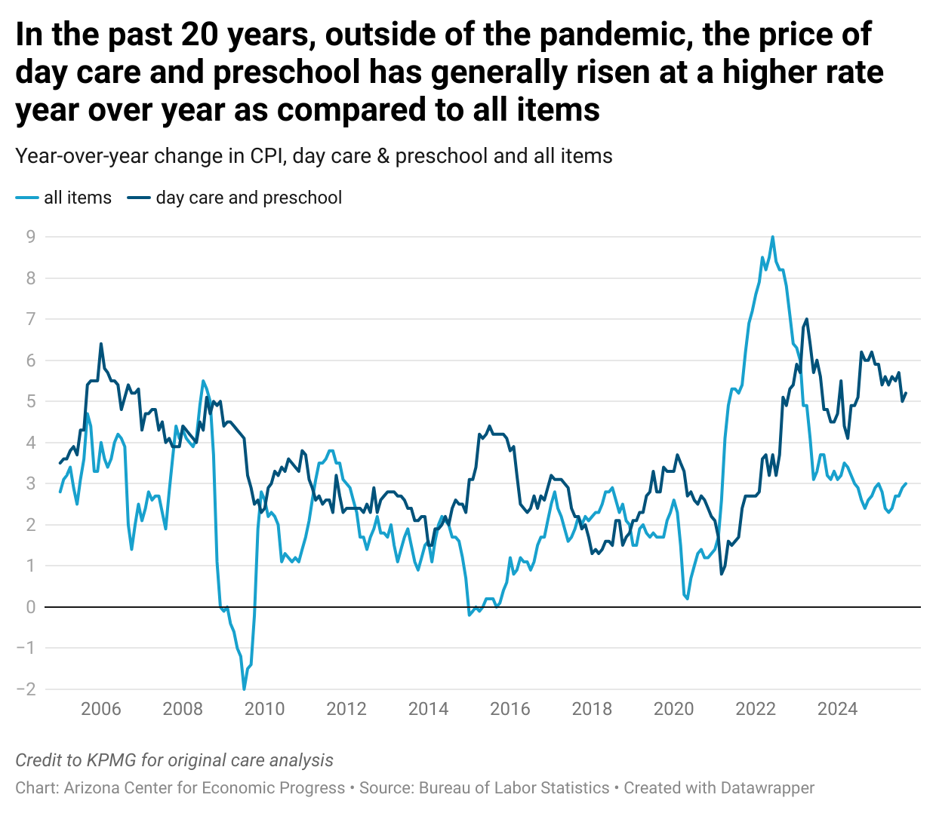

Slide 6
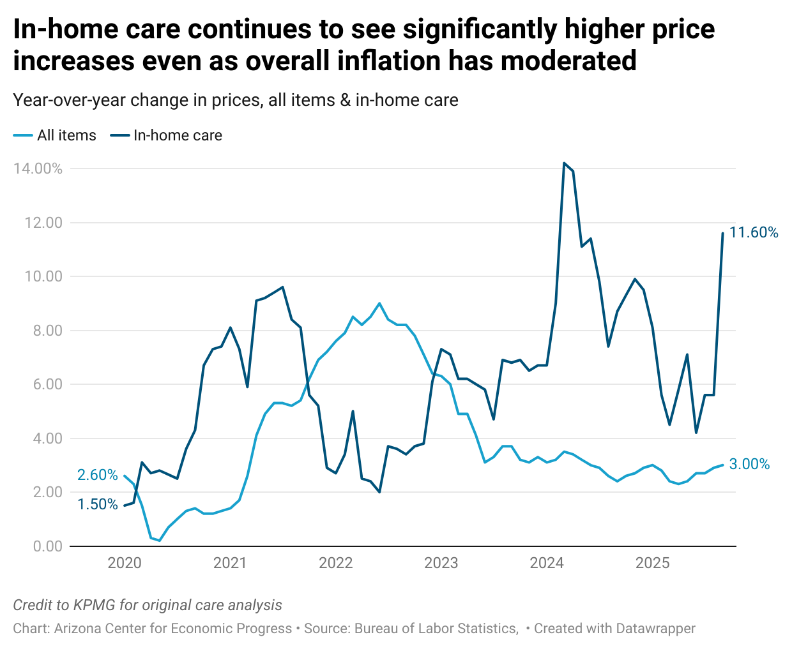

Slide 7
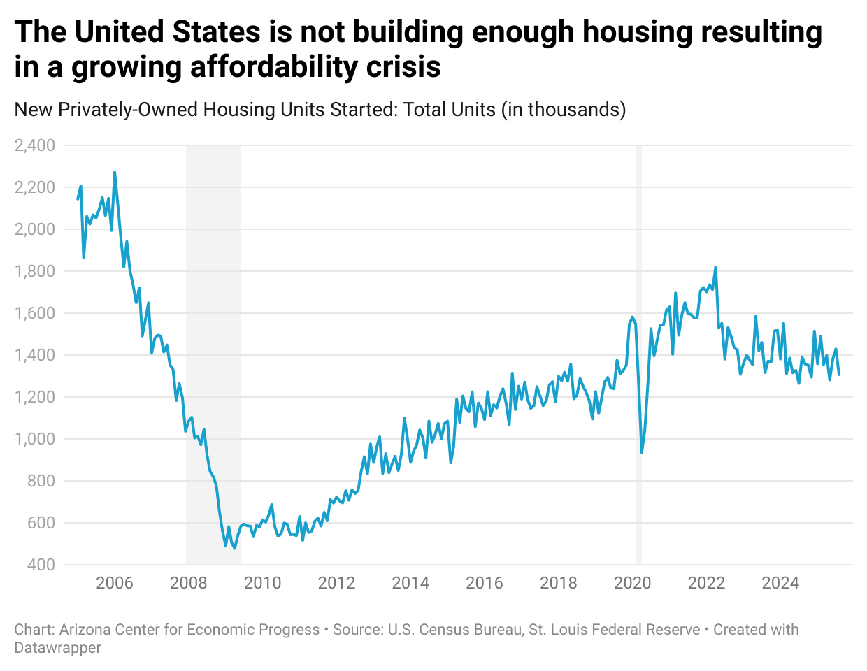

Slide 8
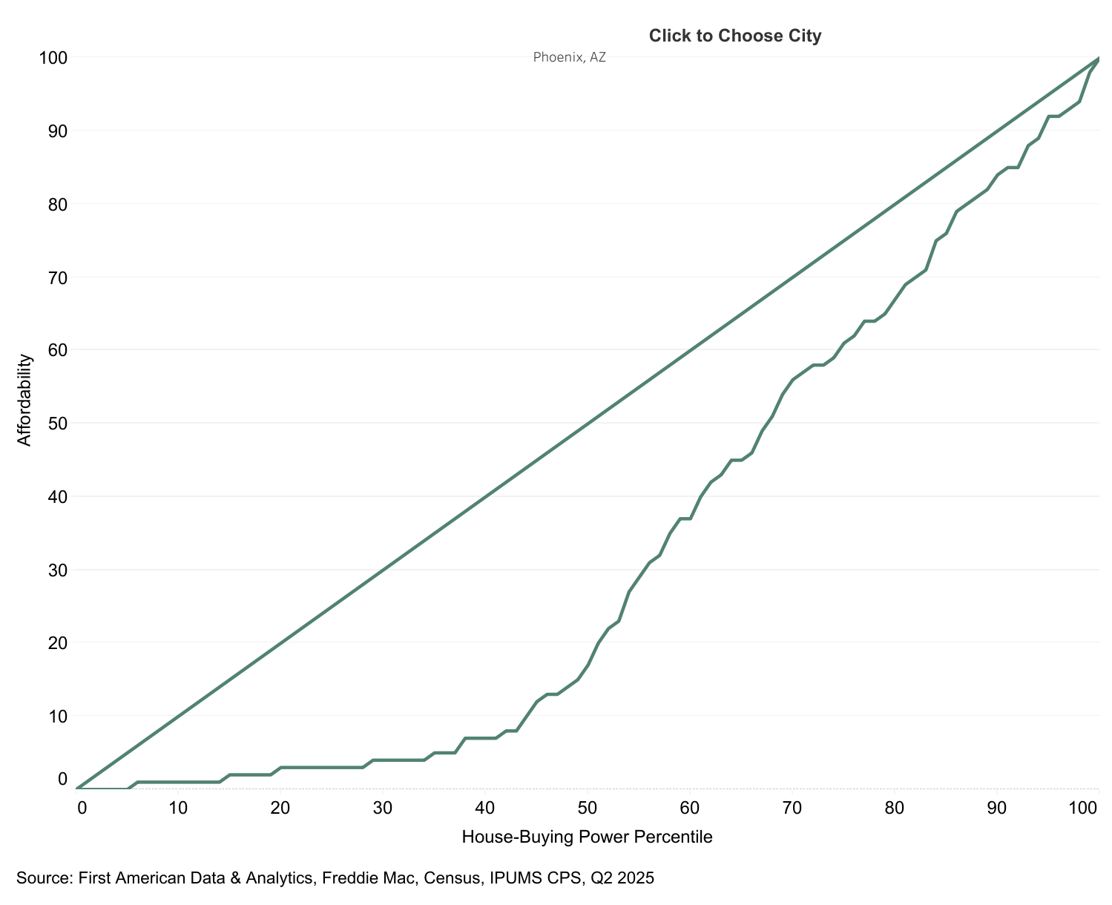

Slide 9
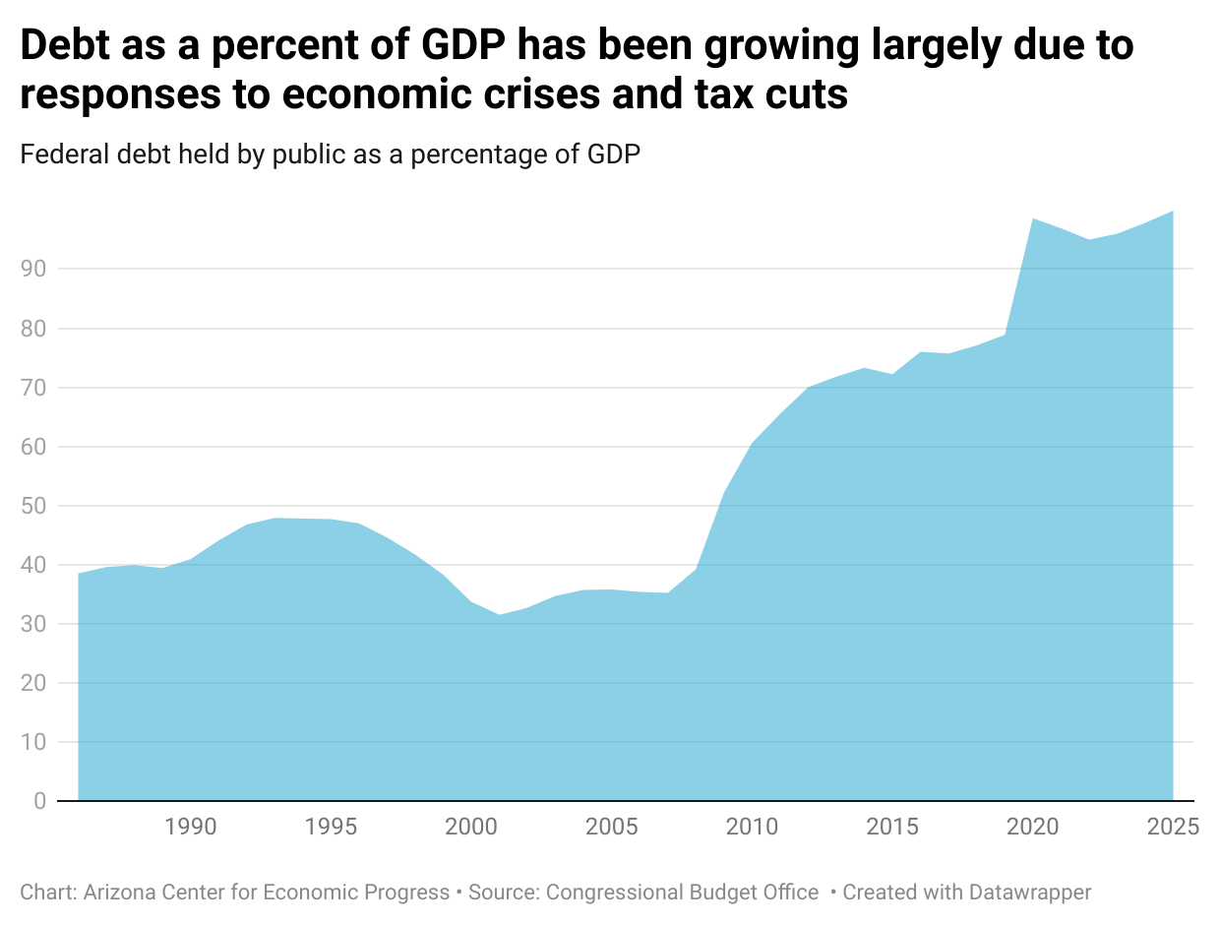

Slide 10
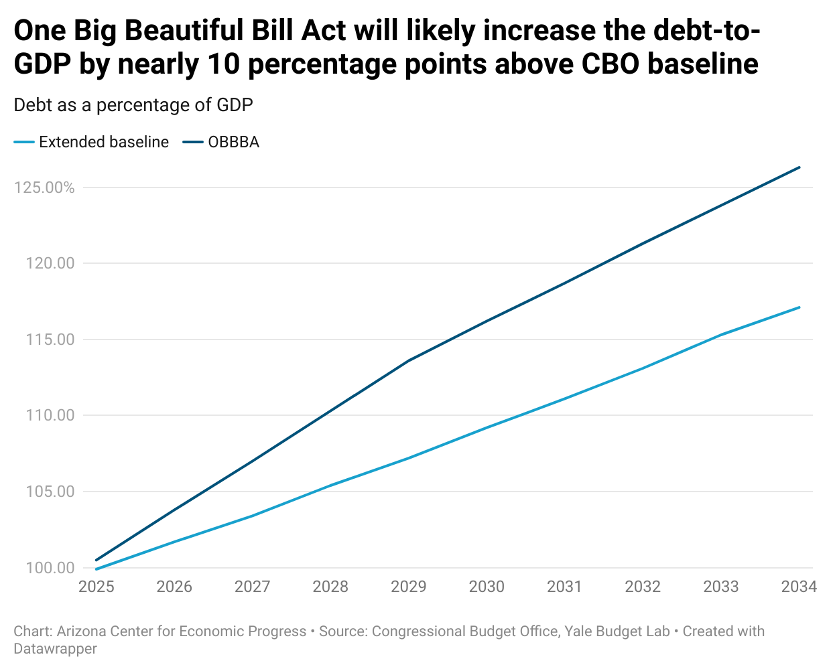

Slide 11
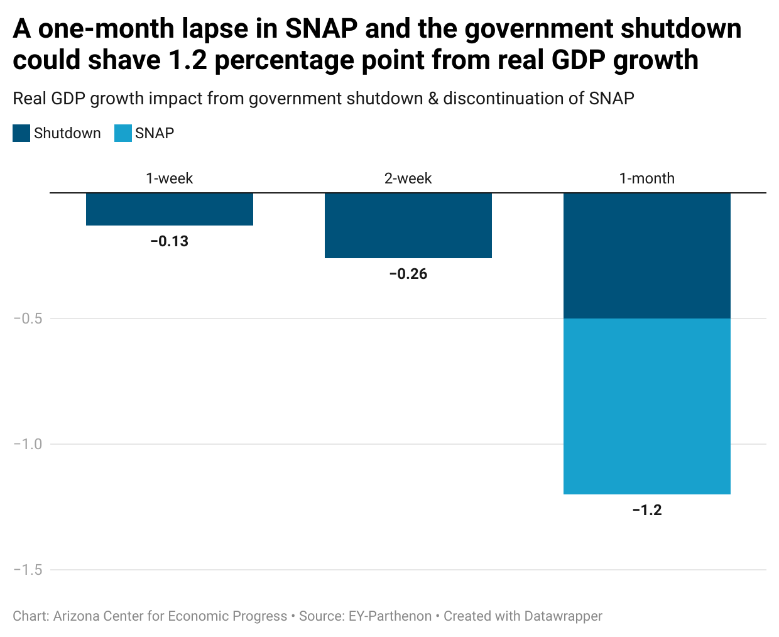

Slide 12
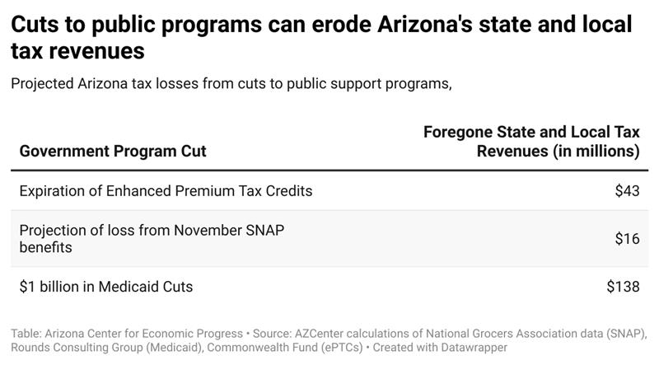

Slide 13
FY 2026 Budget

Slide 14
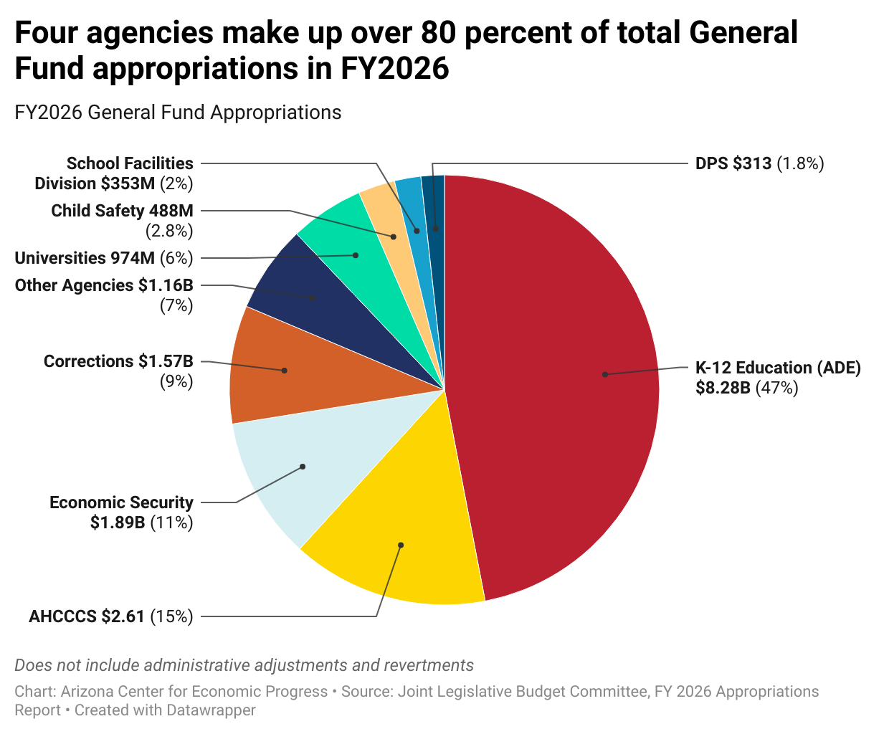

Slide 15
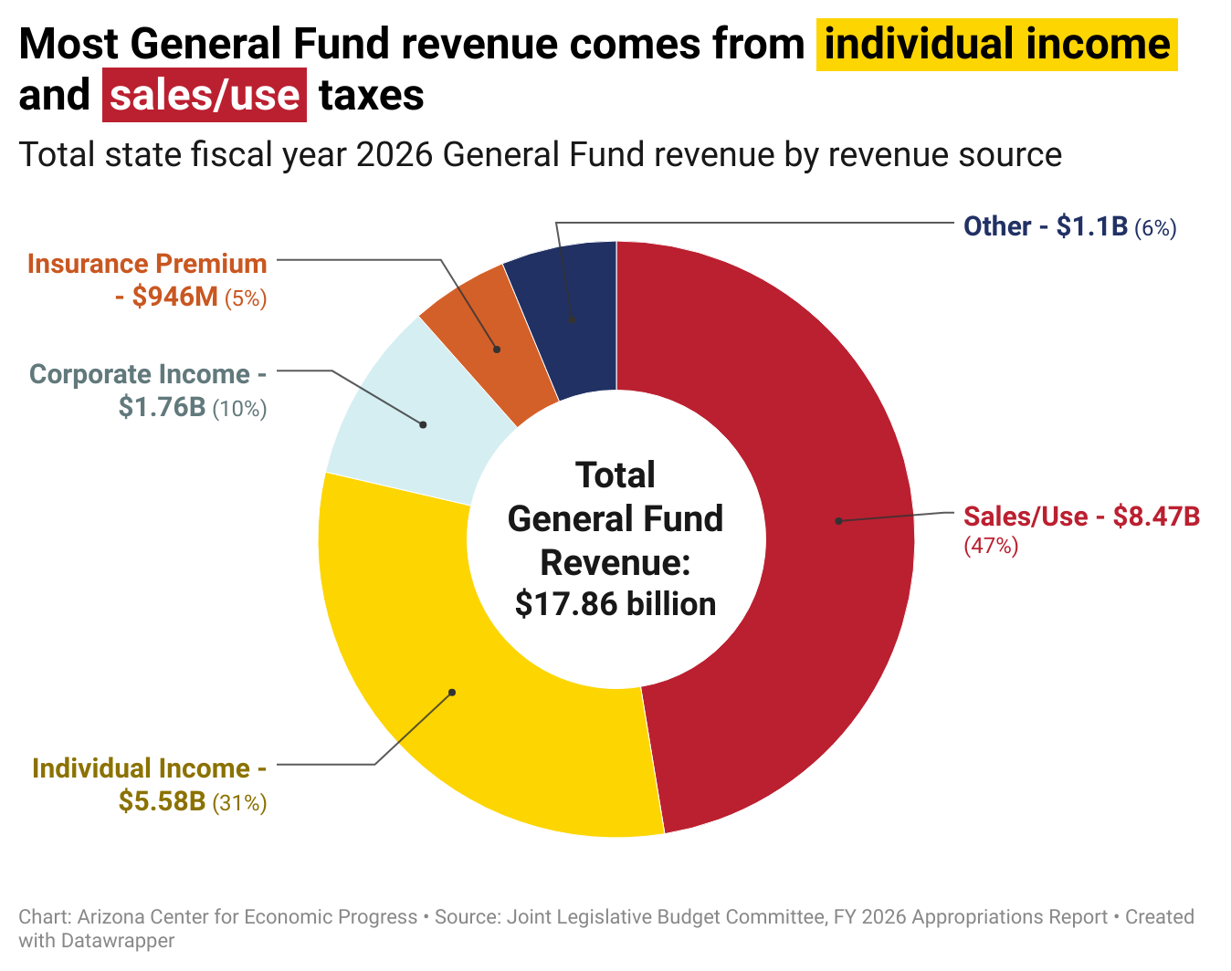

Slide 16
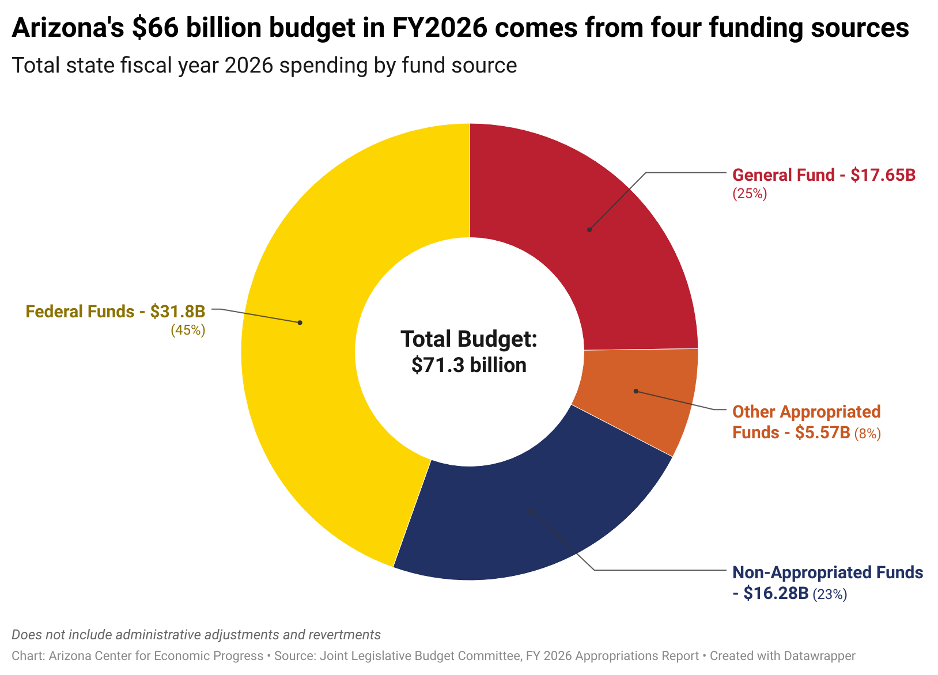

Slide 17
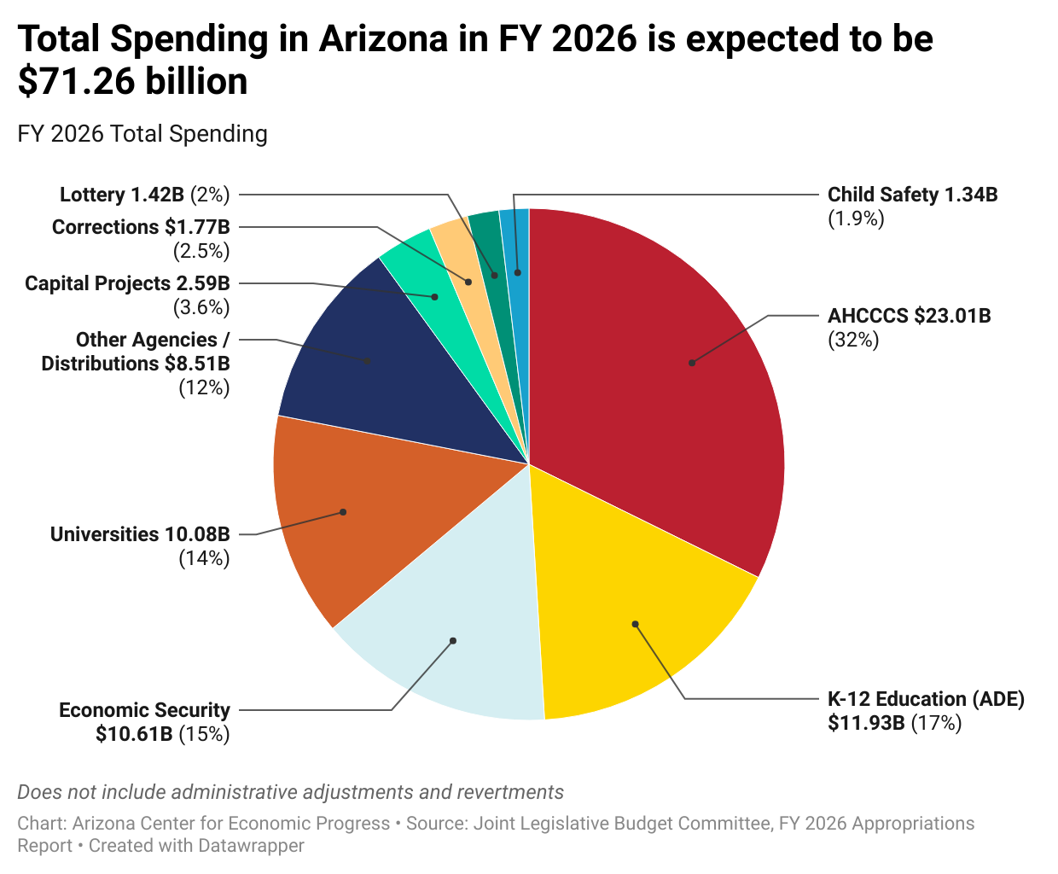

Slide 18
Outlook for Arizona Tax Revenues

Slide 19
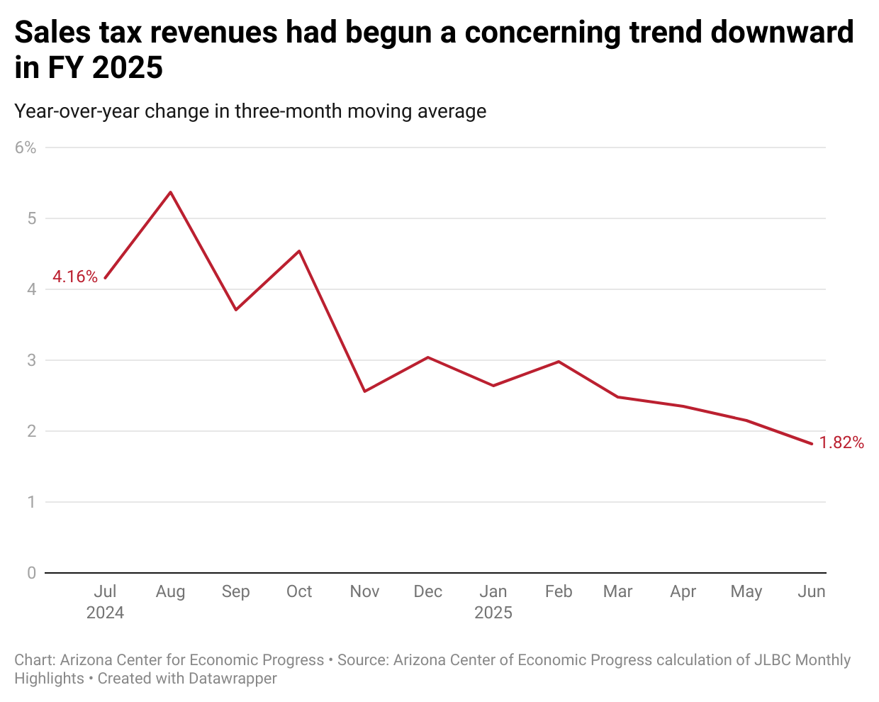

Slide 20
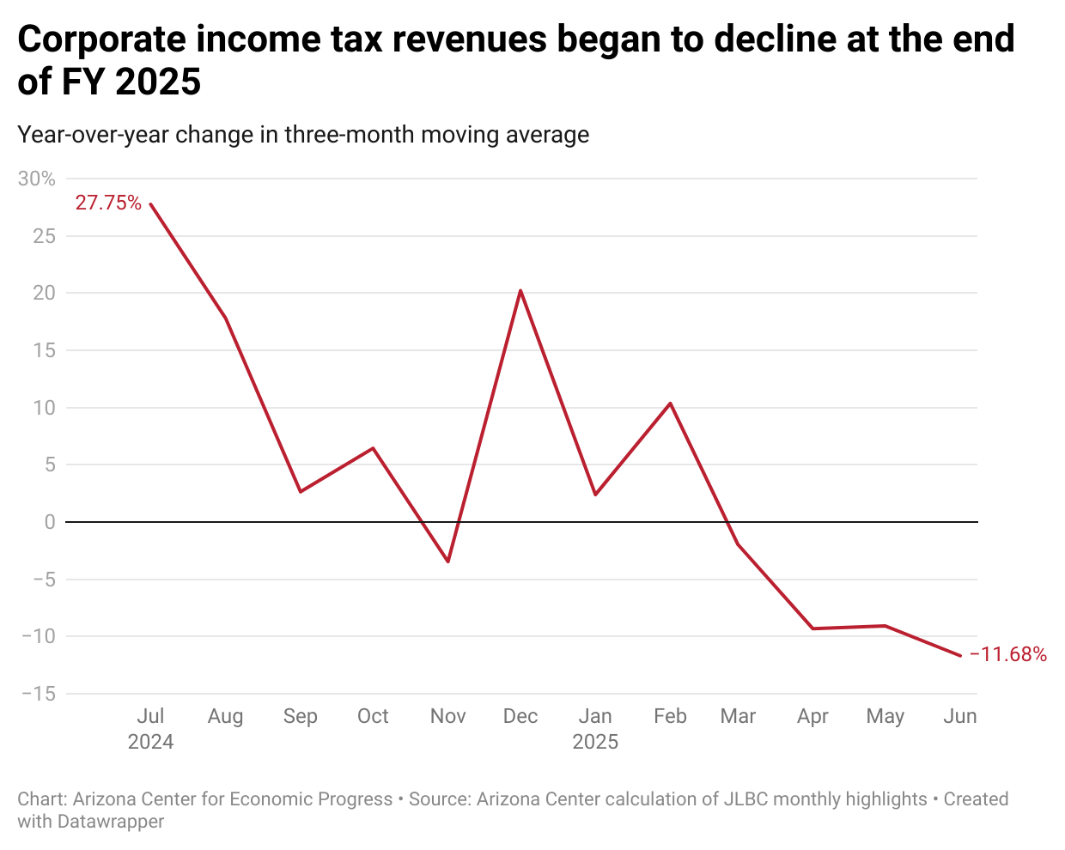

Slide 21
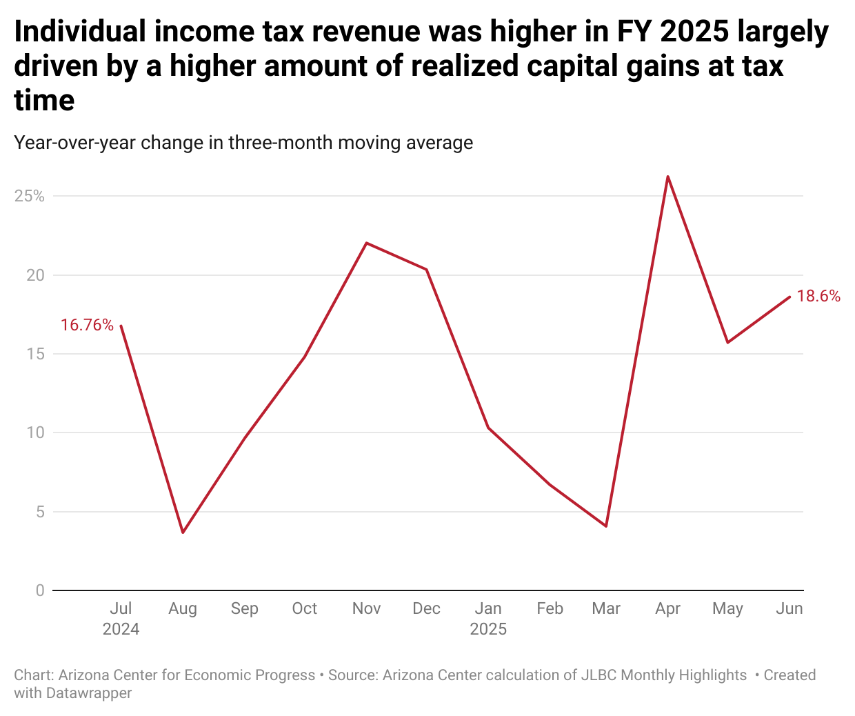

Slide 22
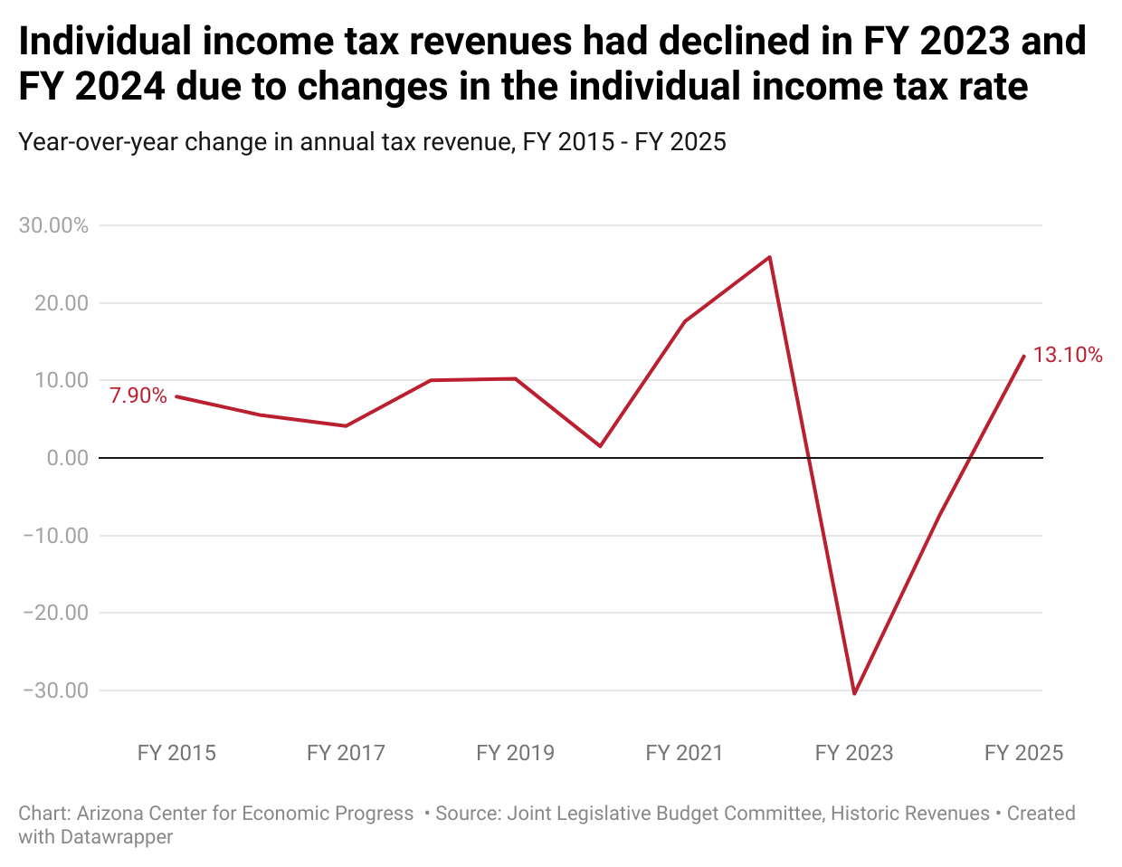

Slide 23
FY 27 Budget & Tax Conformity

Slide 24
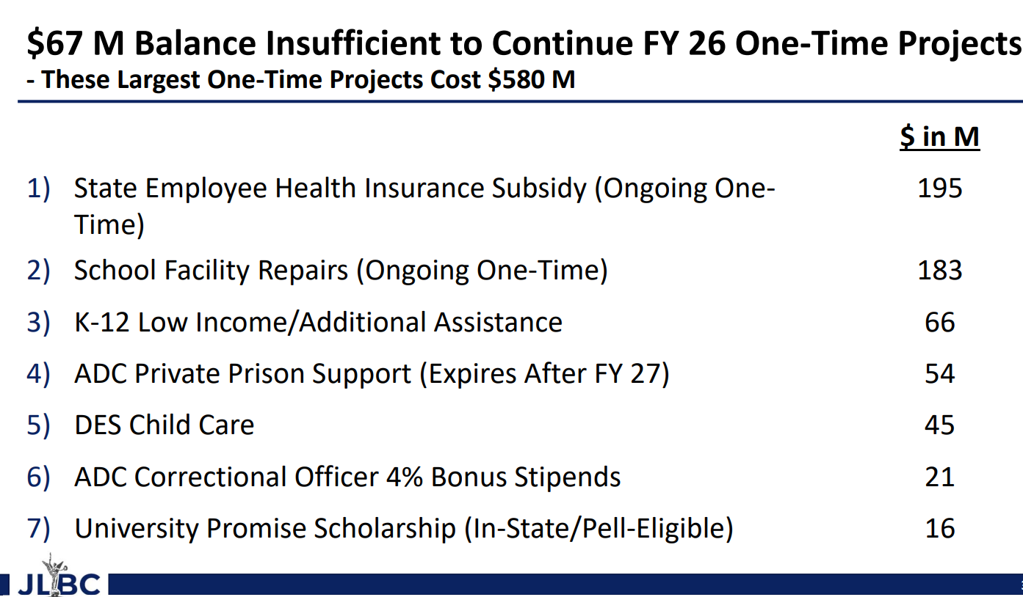

Slide 25
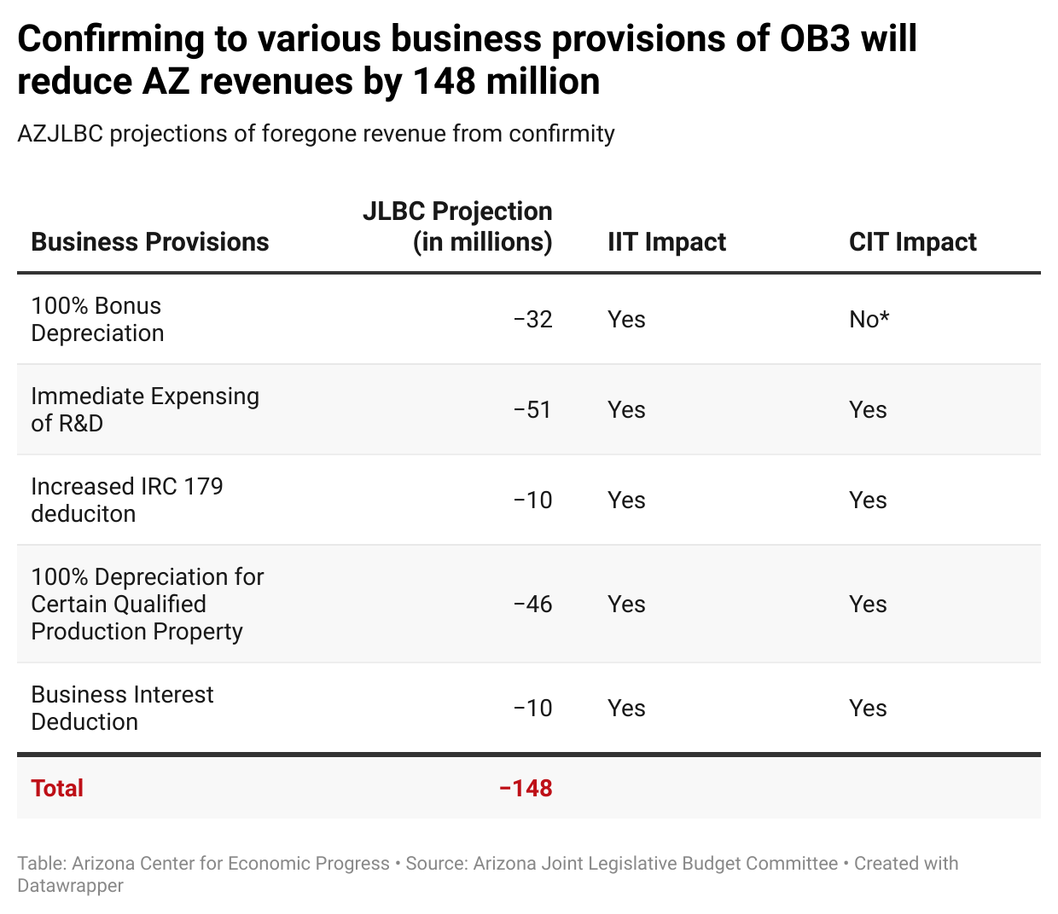

Slide 26
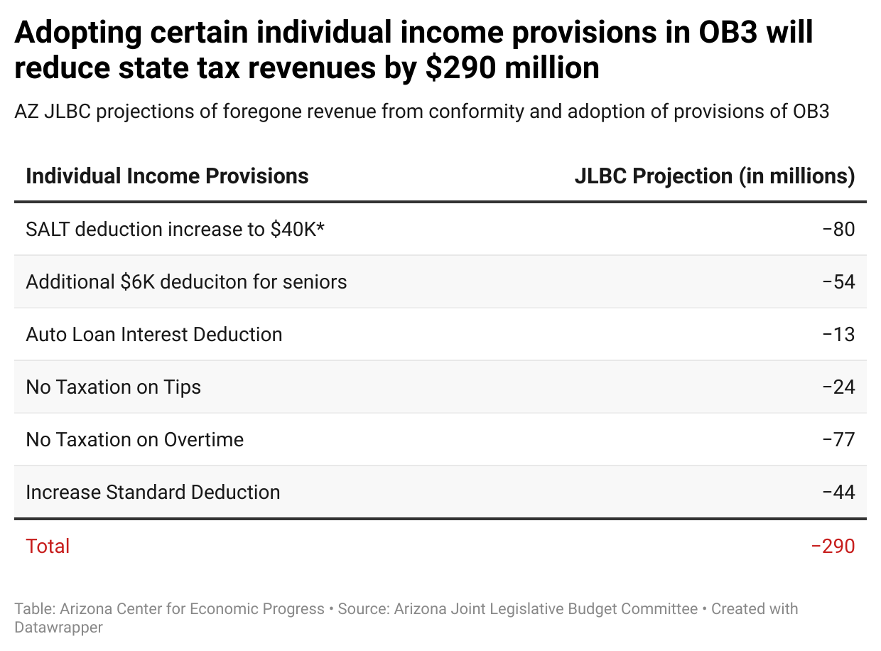

Slide 27
Arizona’s Tax System

Slide 28
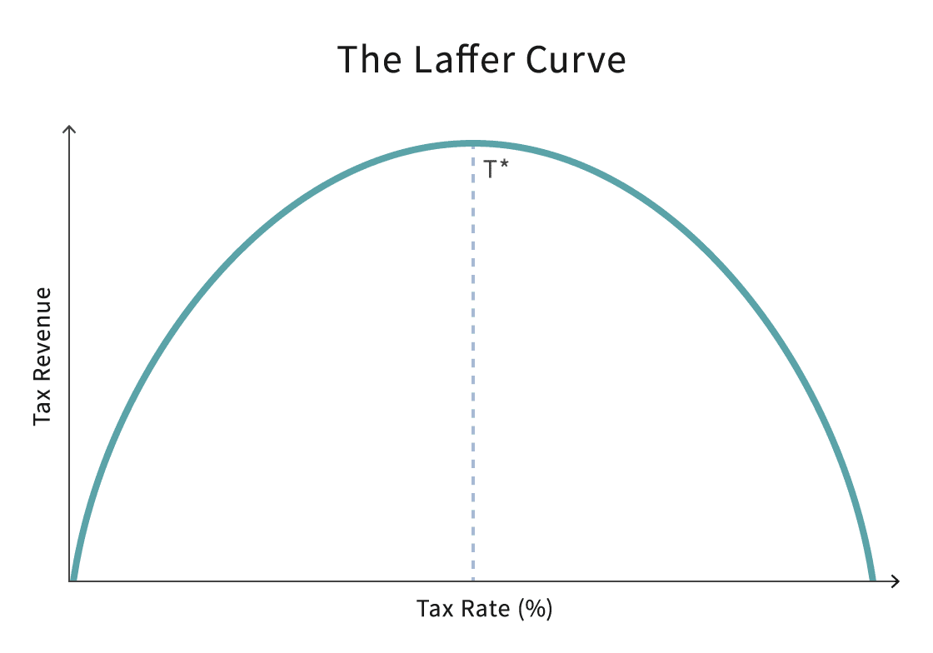

Slide 29
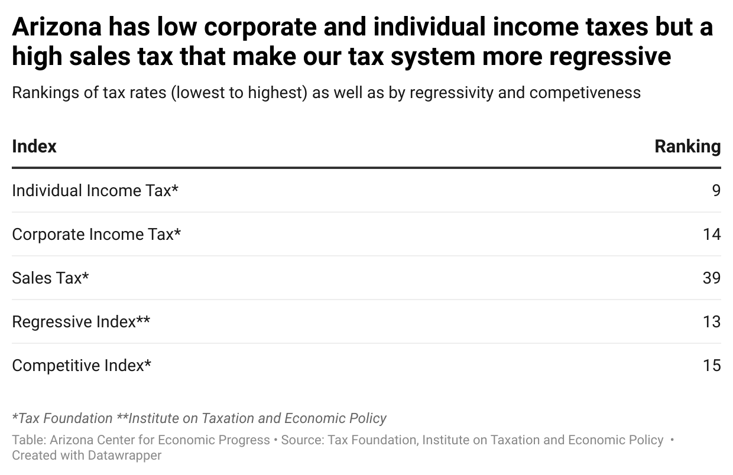

Slide 30
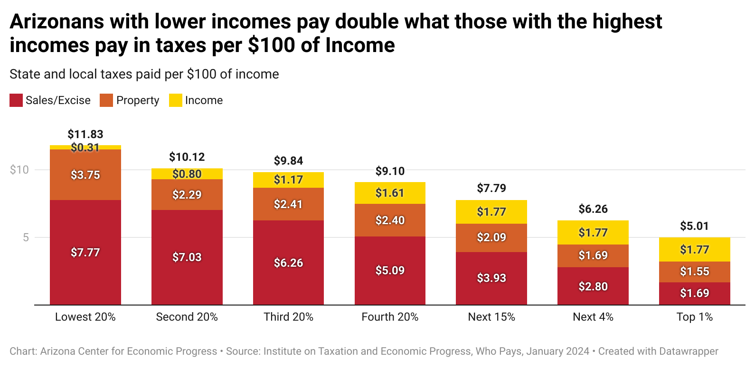

Slide 31
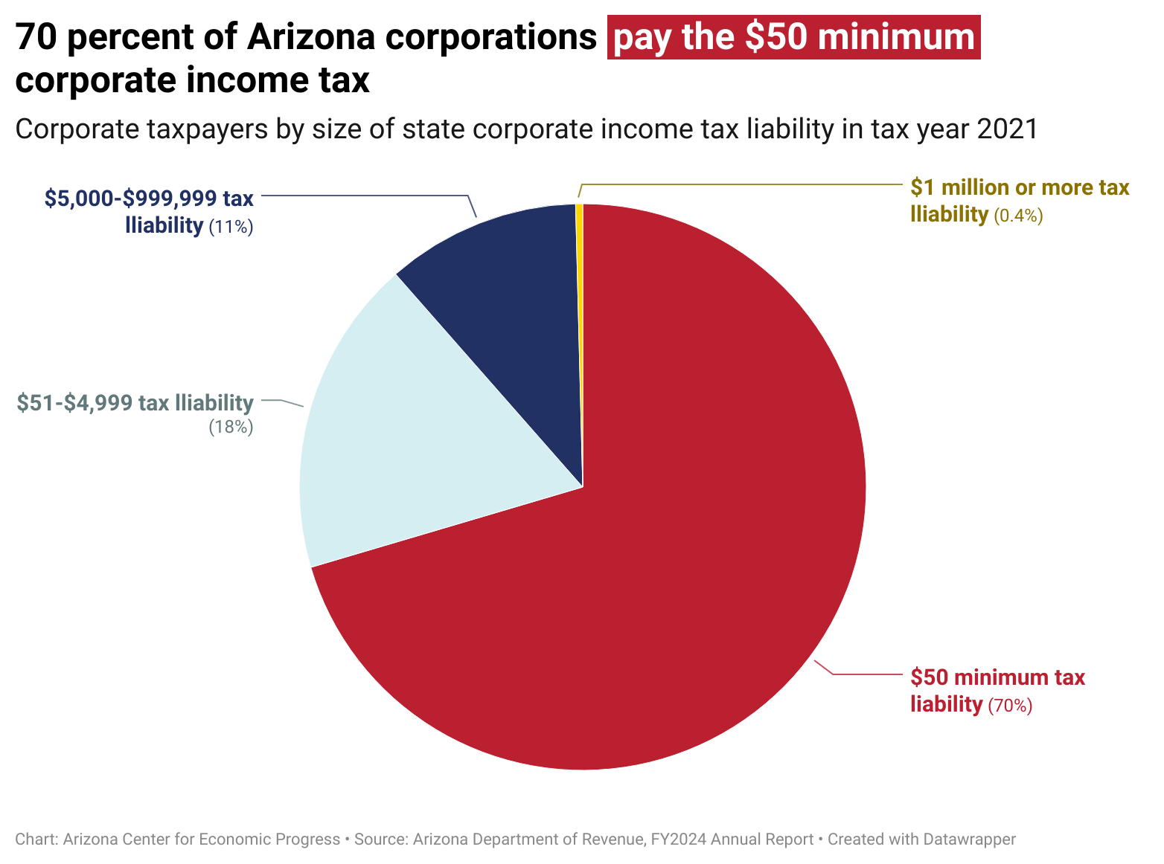

Slide 32
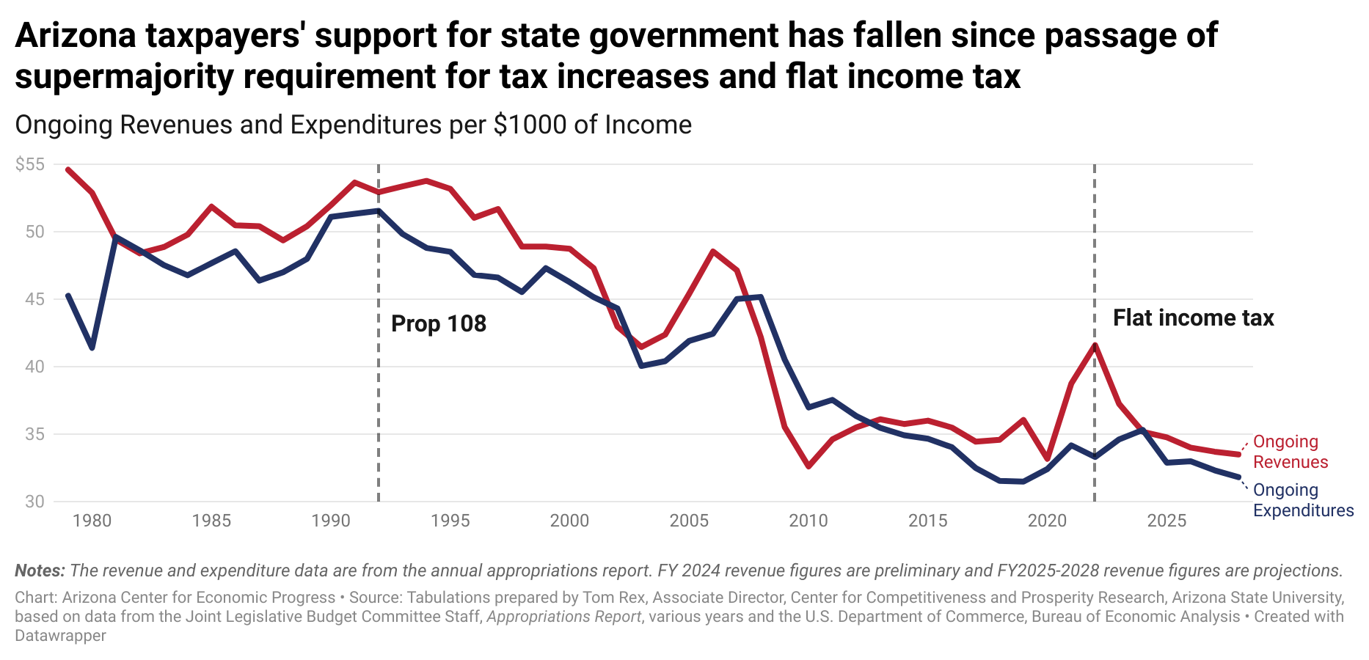

Slide 33
Restrictions on Raising Revenue
Prop 108: Requires the Arizona Legislature to obtain two-thirds vote in both chambers to pass any legislation that will increase revenue.
Prop 132: Requires 60% vote for any tax increase put forward as a ballot referral or voter initiative.
Prop 126: Prohibits state and local governments from creating new taxes or increasing tax rates on services performed in the state.
Prop 200: In exchange for a portion of state income tax revenue, prohibits municipalities from instituting local income taxes.

Slide 34
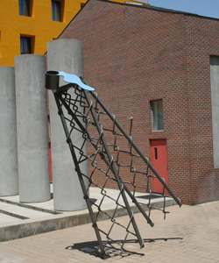
A state budget teetering on the edge

Slide 35
Tax Policy Reforms

Slide 36
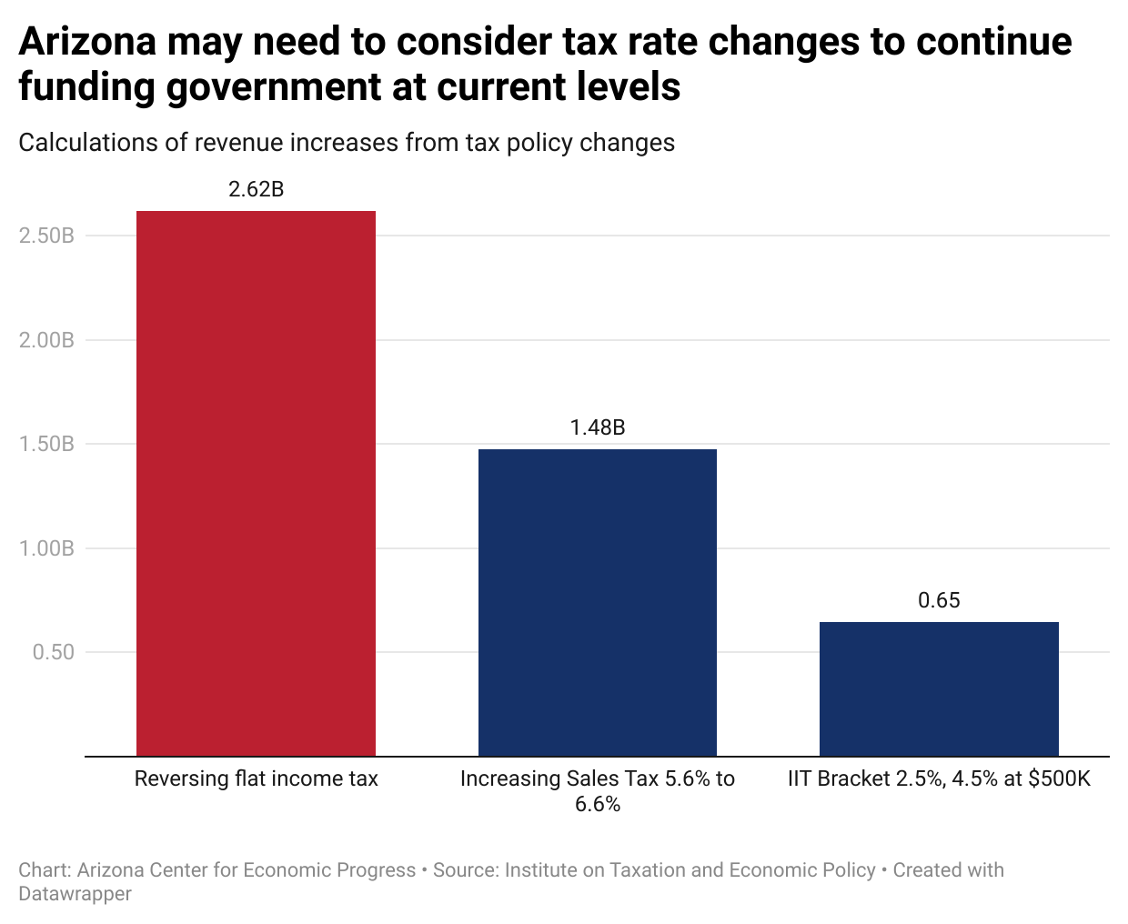

Slide 37
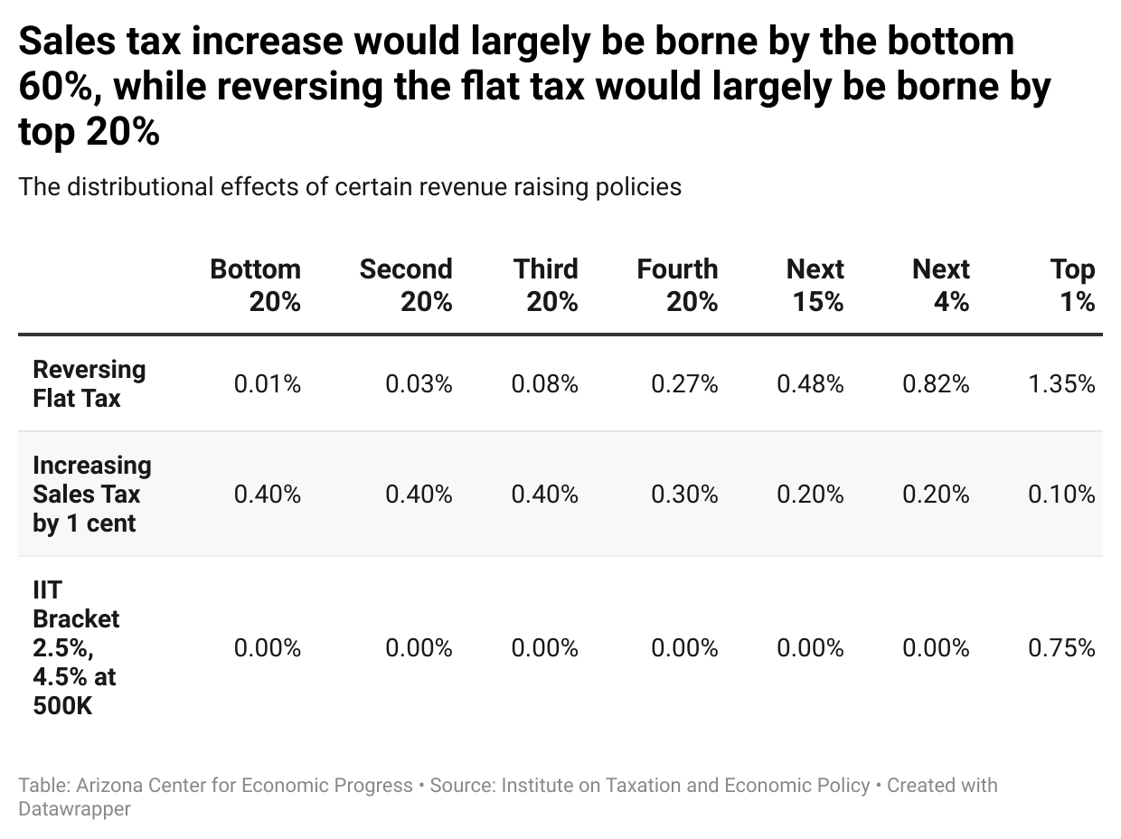

Slide 38
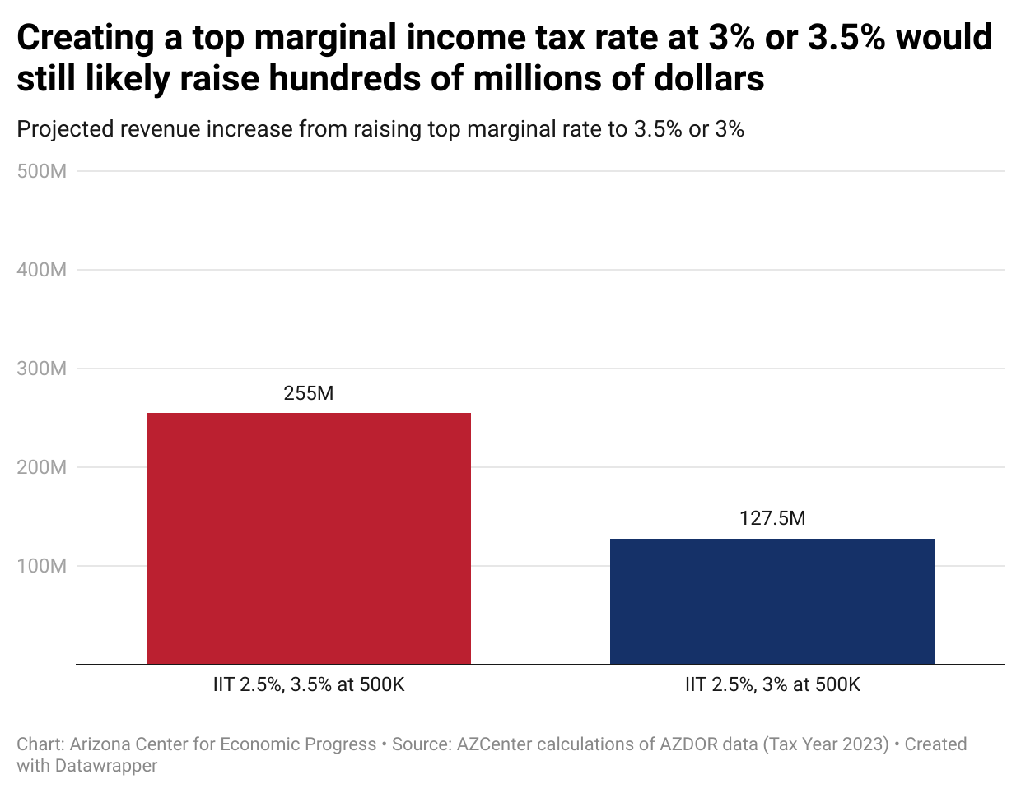

Slide 39
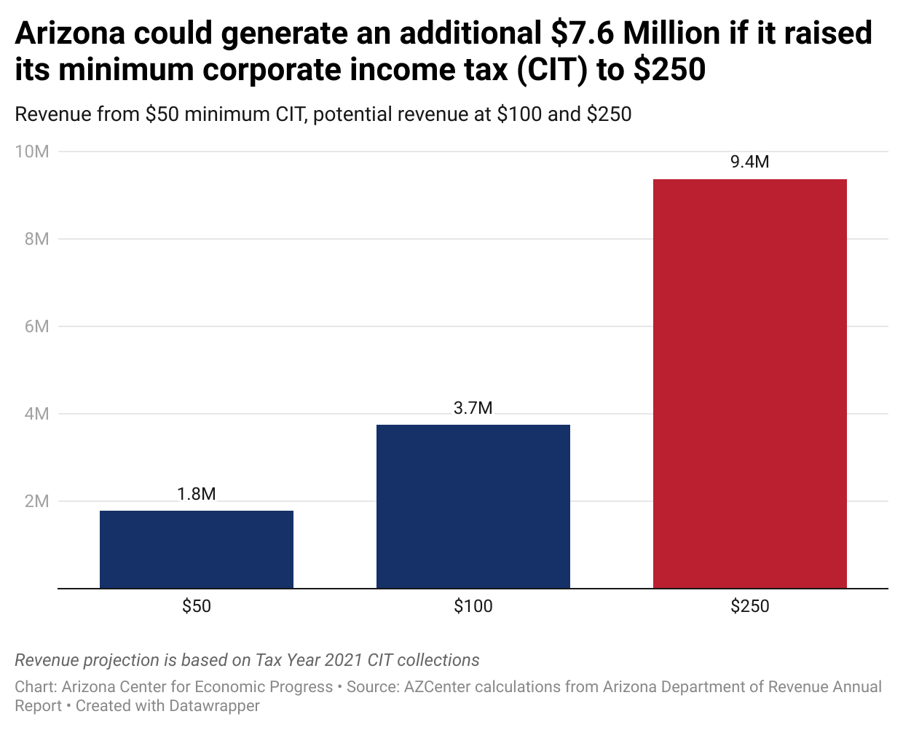

Slide 40
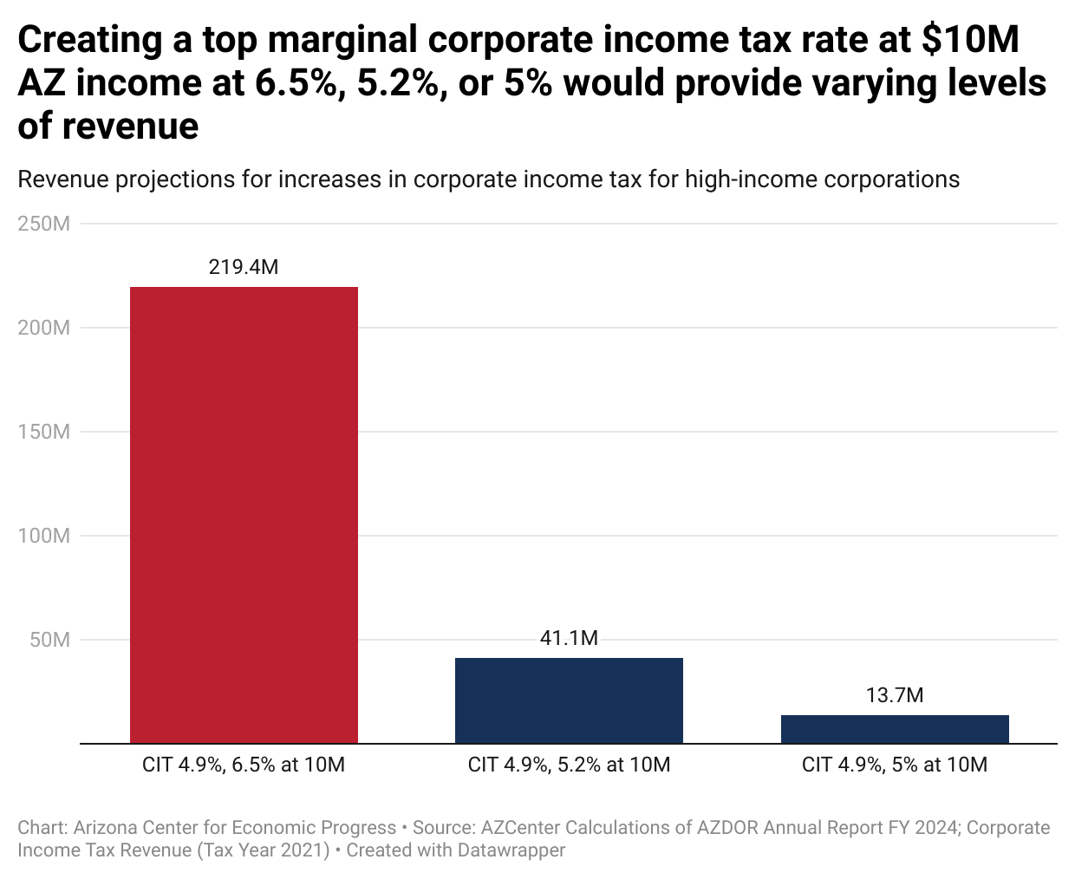

Slide 41
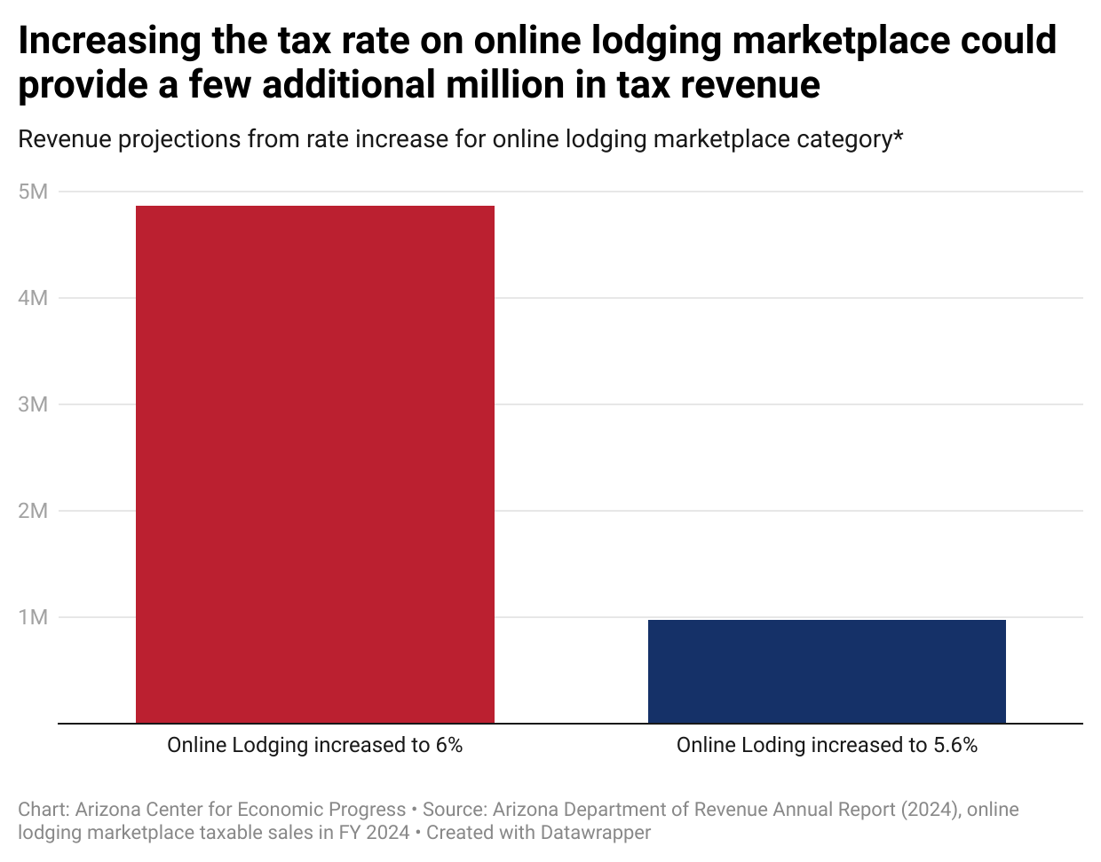

Slide 42
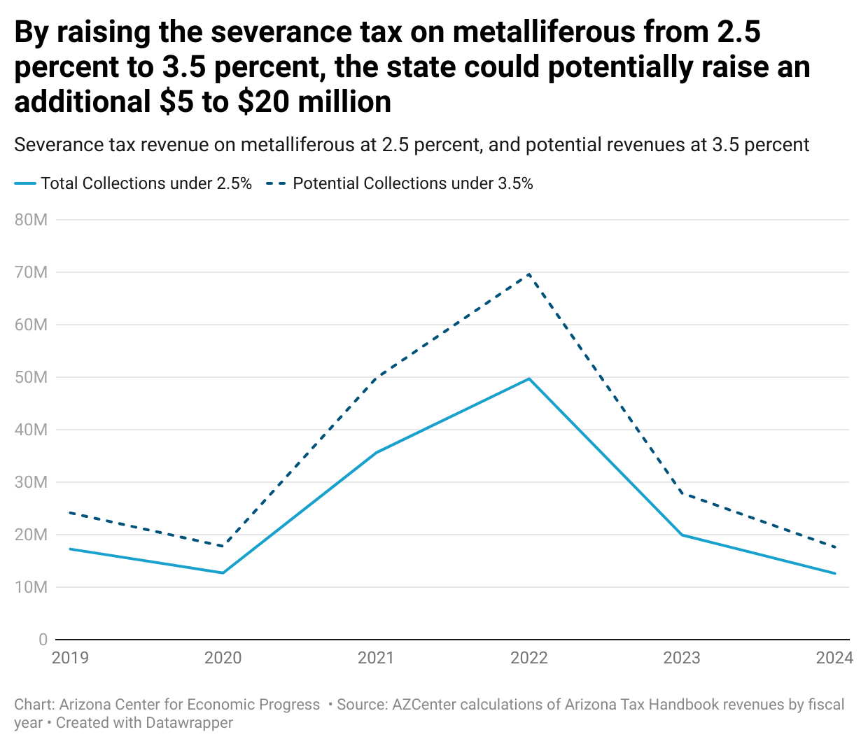

Slide 43
Restrictions on Raising Revenue
Switching from water’s-edge to worldwide reporting of income for multinational corporations (ITEP):
  Revenue increase of $248 million
Instituting a state-level wealth proceeds tax (ITEP):
  1% WPT: $198.4M
  2% WPT: $391.4M
  3% WPT: $578.3M
Eliminating or reforming certain tax reductions:
  TPT deduction for equipment used in data centers: $19.4M
  School Tuition Credit (IIT): $68M
    ESA reform
Additional Resources to audit R&D corporate tax credits:
  Current carryforward is $2.2 billion (Tax Year 2021)

