Slide 1
Sparking Innovation for New Possibilities
A Roadmap to Move
Arizona Forward

Slide 2

What is Innovation?
“Innovation” sounds big--- but it doesn’t have to be
We often think innovation means something brand new or groundbreaking
But true innovation often starts small- it’s the art of improving on what already exists
It’s not about invention- it’s about evolution

Slide 3

Innovation in Action
From DVDs to streaming to storytelling
Innovation is a journey of continual improvement, not one big leap

Slide 4


Innovation in Arizona

Slide 5
Reframing Innovation
Innovation is asking-
“How can we make this better?”
Build on what works
Stay curious and open to improvement
Remember: progress often happens one small idea at a time
Idea
Improvement
Impact

Slide 6

What Already Works?
Working smarter, not harder
Looking to national experts and other states to see what they have learned and build on those lessons
  In doing so, we can:
    Maximize impact
    Reduce duplication
    Make the best use of available resources

Slide 7

Arizona’s Roadmap

Slide 8


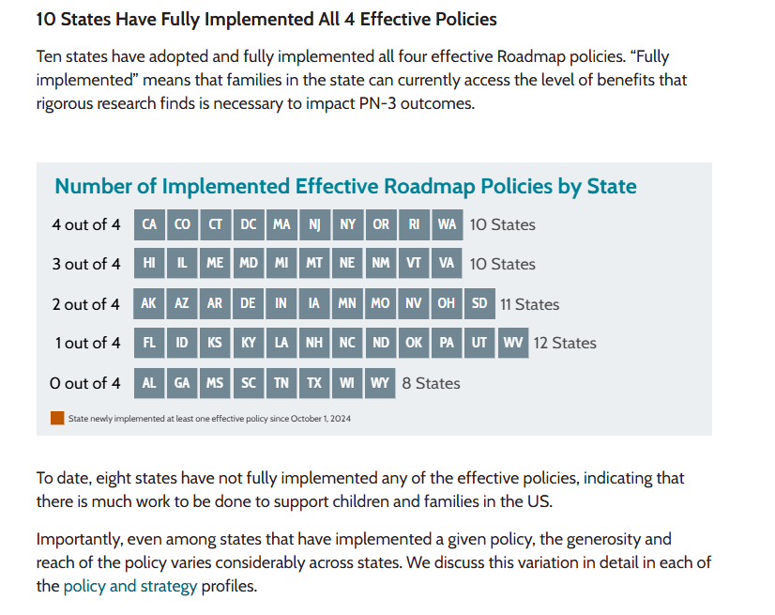

Arizona’s Roadmap

Slide 9
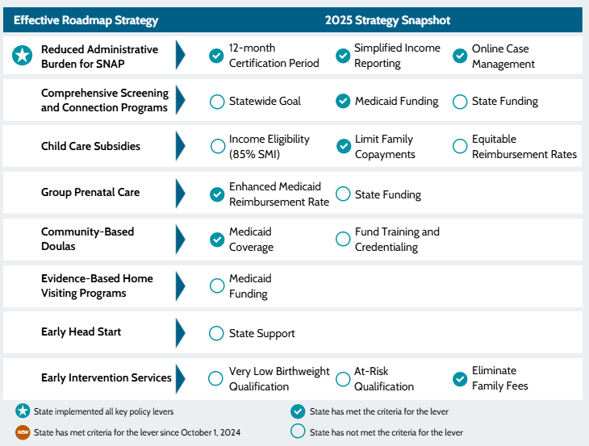
Arizona’s Roadmap
Emerging strategies
Cash transfers are direct monetary payments to individuals or families, typically intended to prevent or mitigate poverty.
Perinatal telehealth services use technology to deliver or enhance health care services or medical training in a remote setting during the perinatal period.
Shared book reading programs provide free, age-appropriate books to children and families with training and guidance on how to read together.
Early literacy coaching programs provide education and training to parents on how to promote their children’s emergent literacy skills.
Child care workforce retention incentives provide temporary financial relief for early educators, often through cash bonuses, tax credits, or scholarships.

Slide 10

We Got This!
Working smarter = doing better, not more
Be strategic, collaborative, evidence-informed, and innovative
Learn from national experts and other states
Adapt proven ideas to fit Arizona
Build stronger systems and supports for families

Slide 11
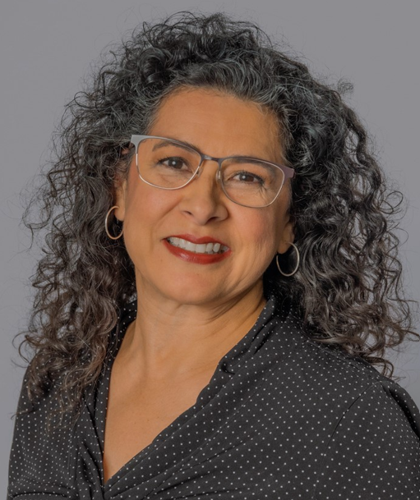
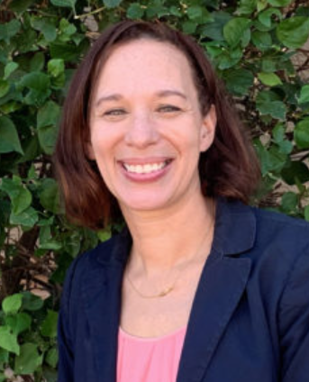
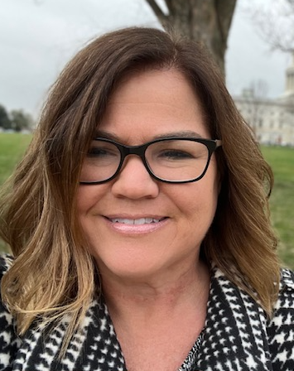

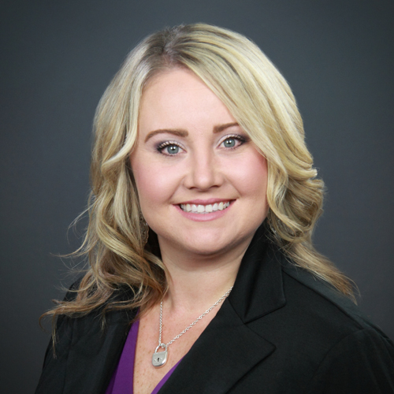
Angela Rabago
Chief External Affairs Officer
First Things First
Lori Masseur
Director of Early Learning
Read On Arizona
Barbie Prinster
Executive Director
Arizona Early Childhood Education Association
Joseph Palomino
Director
Arizona Center for Economic Progress
Amber Jones
Parent &
Early Childhood Advocate

Slide 12
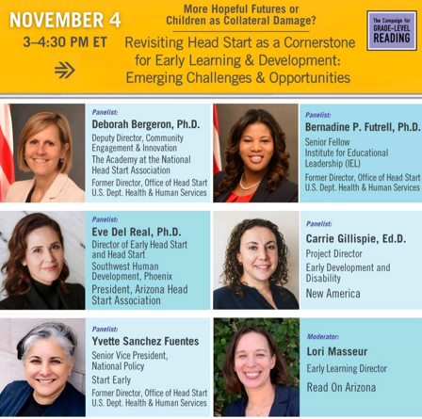
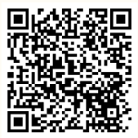
Thank you for attending
Continuing the conversation
Register Here

Slide 13

How Can You Support
Early Childhood?
Connect through
First Things First > Advocate for Early Childhood & advocate for more public support
Attend Early Childhood Day at the Capitol on February 16, 2026
Sign on Letter

