Slide 1
National Perspectives: Policy and Funding Shifts Impacting Children and Families
Children’s Action Alliance - Families First Forum
November 3, 2025
Alberto A. Gonzalez, Jr., MPP
Deputy Senior Director, State Government Relations

Slide 2
Agenda
Brief overview of Medicaid and Supplemental Nutrition Assistance Program (SNAP)
Implications government shutdown has on health coverage and food assistance
Impacts H.R. 1 implementation will have on Medicaid and SNAP
Federal and state advocacy opportunities

Slide 3
Medicaid and Supplemental Nutrition Assistance Program (SNAP):
Lifelines for Millions of Americans, including Arizonans
 | Medicaid | SNAP
# of Participants | ~77M (1 in 5 Americans) Nearly 2M Arizonans, incl. 792K children | ~42M (1 in 8 Americans) About 900K Arizonans, incl. 347K children
Pop. Served | Working Adults, Children, Seniors, Adults with Disabilities, Veterans
Community Impact | State and Local Medicaid Agencies, Rural Hospitals, Clinics, Health Care Systems | State and Local SNAP Agencies, Retailers, Food Systems, Farmers, Producers
Economic Impact | Every $1 spent generates more than a dollar’s worth of local economic activity (*every $1 in SNAP benefits = $1.54 in local economic activity) Drives employment, supports local businesses, stimulates economies, generates state/local tax revenue, saves money for participants, reduces health care costs

Slide 4
Implications Government Shutdown has on Health Coverage and Food Assistance
Health Coverage
Affordable Care Act (ACA) Enhanced Premium Tax Credits (EPTCs) will expire at the end of this year unless Congress takes immediate action in voting to make them permanent
  On November 1, the 2026 ACA Open Enrollment Period launched where millions of consumers are now facing major premium hikes, all while a government shutdown drags on
  More than 370K Arizonans rely on premium tax credits to afford health coverage via HealthCare.Gov
  Nearly 1 in 6 people living in Arizona have a high medical cost burden
  Nearly 1 in 8 people living in Arizona report having trouble paying medical bills
  Arizona Marketplace plans are expected to increase 2.5% to 55% for 2026
Food Assistance
USDA has decided to not release contingency funds to cover SNAP benefits in November, leaving more than 42M Americans without access to grocery benefits
  Note: On 10/31, federal judges ruled that USDA cannot suspend benefits during the government shutdown
    About 900K Arizonans rely on SNAP benefits to afford groceries every month
    More than 68% of Arizona SNAP participants are in families with children

Slide 5
Historic Changes to Medicaid/CHIP, Marketplace, and SNAP
H.R. 1 Implementation
  Coverage and Access Implications
  Work Reporting Requirements for SNAP and Medicaid
  6-month redeterminations for Medicaid Expansion population
  Retroactive coverage limitations for Medicaid Expansion population
  Eligibility and Enrollment Hurdles
    Moratorium on CMS Rule to simplify Medicaid/CHIP enrollment
  Restrictions for certain immigrant populations to access Medicaid and SNAP and afford ACA Marketplace plans
Final Marketplace Rule
  Makes DACA recipients ineligible for ACA Marketplace Plans
  Shortens ACA Open Enrollment Period for Plan Year 2027
  Financial Implications
  Medicaid
    Provider tax rates
    State directed payments
    Budget neutrality for Medicaid demonstration projects (inc. AZ's 1115 Waiver)
  SNAP
    Cuts to SNAP benefits for those on LIHEAP; no longer able to deduct internet costs
    Cost-shifts to States to cover high share of administrative costs + benefits based on error rates
  Marketplace
    Increase in premiums and annual cost-sharing; health care costs will continue to rise for consumers

Slide 6
Challenges to Implementing Medicaid/CHIP, SNAP, and Marketplace Changes
State Implementation Challenges
Significant updates to Medicaid and SNAP eligibility and enrollment systems
Establishing data-sharing arrangements across other state programs (this can take months to years)
Accurately identifying whether requirements/exemptions are being met
Large IT investments and staffing
Communications plan to notify enrollees of the changes
Limited number of vendors to do the work
Limited state resources to make these things happen within tight timelines and budgets
Cumulative Impact on State Health Care, Food and Nutrition Systems
Millions of residents lose Medicaid/CHIP and Marketplace coverage and SNAP benefits. According to the CBO, once H.R. 1 is fully in effect:
  10 million fewer people will have Medicaid/CHIP coverage and about 4 million people in a typical month will lose some or all of their SNAP food benefits.
Increases in uncompensated care, visits to local food banks, and food insecurity
Hospital closures, impacts to SNAP-authorized retailers’ bottom line
Job losses in the health care, food, and agriculture industry
Economic instability for families, including those in rural and agricultural communities
Limited access to Medicaid providers, especially in rural areas

Slide 7
Challenges to Implementing Medicaid/CHIP, SNAP, and Marketplace Changes
State Implementation Challenges
Significant updates to Medicaid and SNAP eligibility and enrollment systems
Establishing data-sharing arrangements across other state programs (this can take months to years)
Accurately identifying whether requirements/exemptions are being met
Large IT investments and staffing
Communications plan to notify enrollees of the changes
Limited number of vendors to do the work
Limited state resources to make these things happen within tight timelines and budgets
Cumulative Impact on State Health Care, Food and Nutrition Systems
Millions of residents lose Medicaid/CHIP and Marketplace coverage and SNAP benefits. According to the CBO, once H.R. 1 is fully in effect:
  10 million fewer people will have Medicaid/CHIP coverage and about 4 million people in a typical month will lose some or all of their SNAP food benefits
Increases in uncompensated care, visits to local food banks, and food insecurity
Hospital closures, impacts to SNAP-authorized retailers’ bottom line
Job losses in the health care, food, and agriculture industry
Economic instability for families, including those in rural and agricultural communities
Limited access to Medicaid providers, especially in rural areas

Slide 8
What Can You Do?
Call on Congress and the Administration to permanently extend ePTCs and fully fund SNAP
Call on State Leaders to continue prioritizing funding for state health and nutrition assistance programs ahead of the 2026 State Legislative Session and utilize every available tool to minimize the harm of H.R. 1
  Food Bucks Now in AZ
Document the harm that H.R. 1 is having in the communities you serve
  Support story banking and story telling initiatives
Raise awareness among the communities you serve about these changes
  Update contact information, including mailing addresses with state agencies
Support collaborations between State/Local Agencies and CBOs to continue educating and informing program participants about eligibility and benefit changes

Slide 9
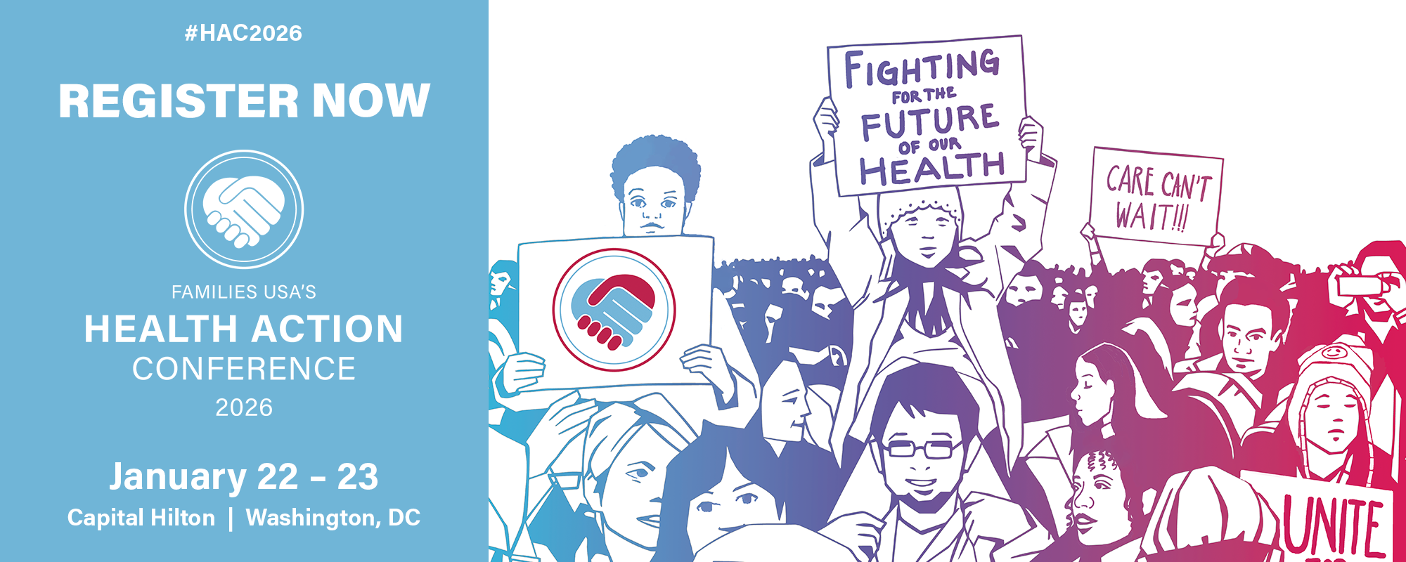
Thank You
Alberto A. Gonzalez, Jr.
Deputy Senior Director
State Government Relations
Families USA
Agonzalez@familiesusa.org
Website: FamiliesUSA.org
Follow us on social media @FamiliesUSA !

